Slide 1
INFOhio ILibrarians
Just a few of the things we’ll be working on…
collaborating with INFOhio teams and connecting with teachers and students to increase virtual reference and digital instruction.
aligning INFOhio’s curriculum content work to Ohio Learning Standards and the next generation of assessments.
working closely with low wealth districts and schools to provide and model digital library services.
promoting INFOhio digital products and services to schools, teachers, and state organizations.

Slide 2
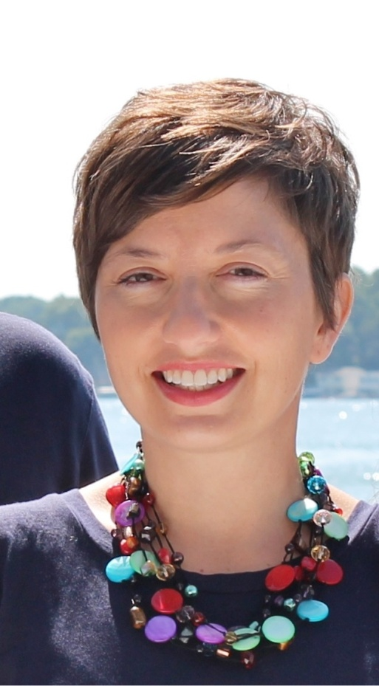
INFOhio ILibrarian – Erica Clay
I will focus on increasing online information literacy skills for students, coordinating services with OhioLINK, and connecting students to online learning modules through virtual reference.
Education:
Bachelor of Arts in English and Music, Wright State
Master of Humanities, Wright State
Master of Library Science, Indiana University
Teaching/Library experience:
Pre-K, K-8 Music
Humanities Librarian at Wright State University
Library Director at University of Northwestern Ohio

Slide 3
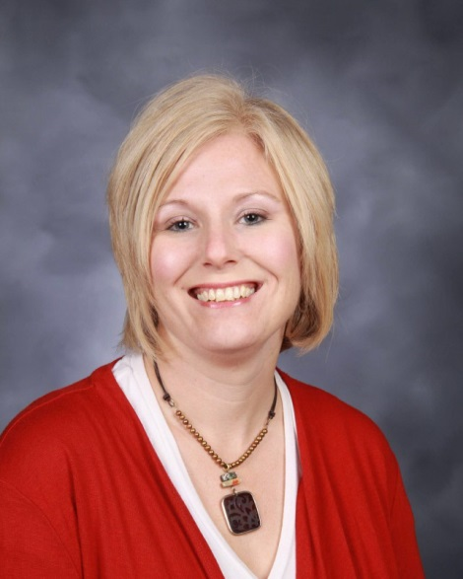
INFOhio ILibrarian – Emily Rozmus
I will focus on alignment of INFOhio resources with standards, assessment and professional practice, connect with public libraries to improve literacy and support the 3rd Grade Reading Guarantee, and create blended learning modules to support digital learning at public, charter and online schools.
Education:
BGSU – BS in education
Wright State – Masters in education with focus on library science
Teaching/Library Experience:
20 years of experience teaching English in public schools (Mechanicsburg Exmpt. Village)
8 years of experience in admin/teaching in the K-12 school library

Slide 4
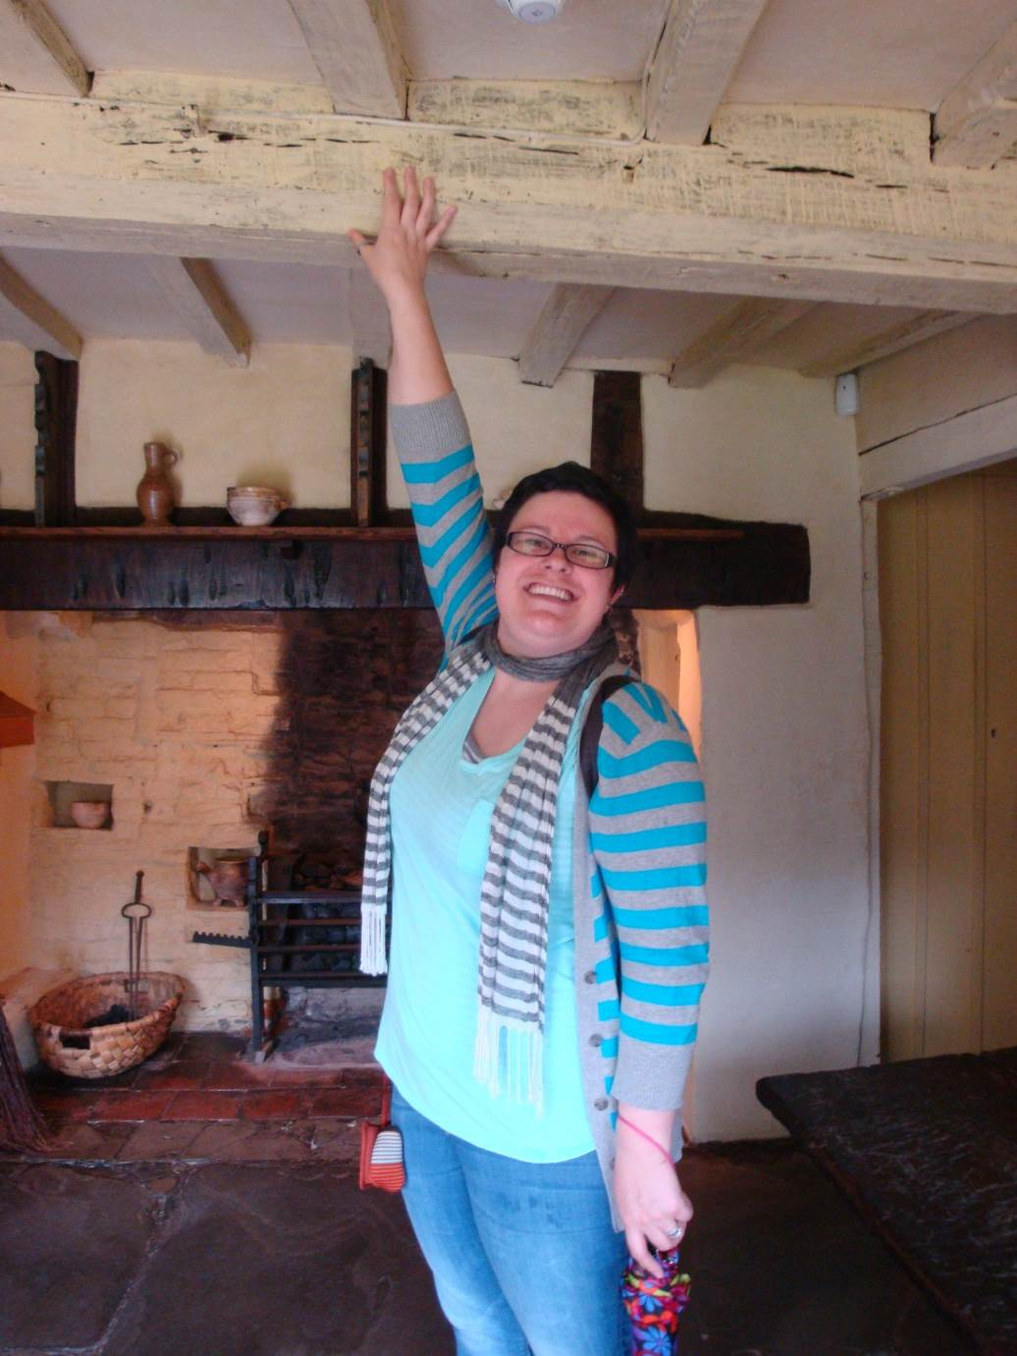
INFOhio ILibrarian – Brandi Young
I will focus on promoting online reading programs for students, classroom applications for Web 2.0 curation technologies, and exploring the best ways to support student achievement with new technologies such as MakerSpaces.
Education:
Bachelor’s of Science in Education, Ohio University
Masters in Library Information Sciences, Kent State University
Teaching/Library Experience:
9-12 English Language Arts
6-8 Library Media Specialist
K-5 Library Media Specialist

Slide 5
INFOhio ILibrarians – Contact Info
Erica Clay:
clay@infohio.org
419.203.7603
Emily Rozmus:
rozmus@infohio.org
614.485.6731
Brandi Young:
young@infohio.org
614.425.0046

