Slide 1
Library User Group September 10, 2013
1:00 PM
Presented by Autumn Roper
Northeast Ohio Management Information Network

Slide 2
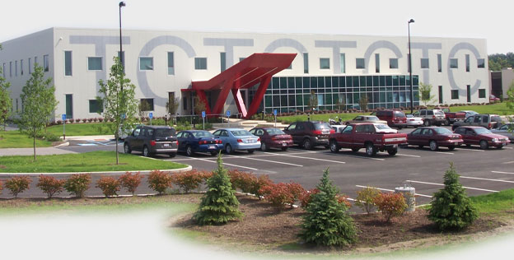
Welcome & Introductions
Autumn Roper, Coordinator of Library Application Support Northeast Ohio Management Information Network
What’s your name & building?

Slide 3
Building Changes
Niles Washington = Niles Intermediate
Niles Rhodes/Jackson = Niles Primary
Mineral Ridge MS closed (HS 7-12, ES PS-6)
Champion ES & MS libraries are open this year! ☺

Slide 4
Staff Changes
Rosanne Dando, Newton Falls HS (retired)
Saundra Lyons, Bloomfield ES (new)
Debby Brinsey, Bascom ES, LaBrae (new)
Linda Repasky, JFKHS (retired)
Laura Henning, TCTC (new)
Terry Clutter (resigned to another job)

Slide 5
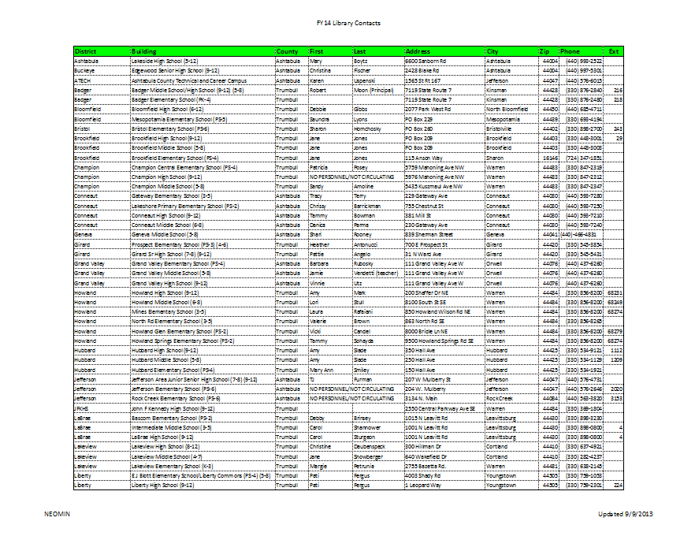
NEOMIN Library Contacts
Handout

Slide 6
User Group Meetings
Eight meetings this year
2013: 9/10, 10/10, 11/12, 12/17
2014: 1/14, 2/11, 3/20, 4/29
Five meetings have AM/PM times

Slide 7
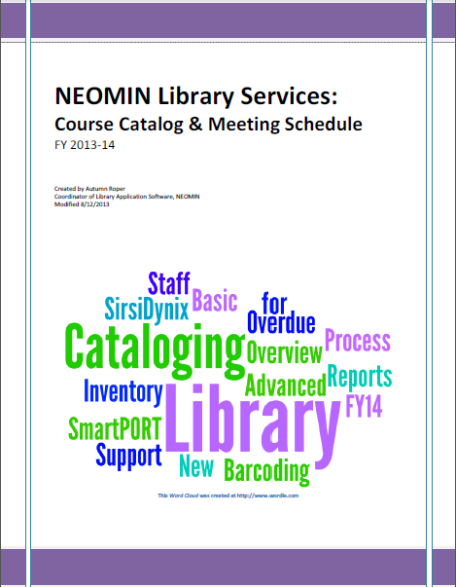
Training Schedule
Course Catalog & Meeting Schedule handout
Handout

Slide 8
Present.me
Thoughts?
Do you see a use for Booktalks?

Slide 9
Present.me

Slide 10
Symphony SP3
Log into Workflows, go to Help, Contents…
Handbook updates after SP3:
3.5, Online Help
4.4, Modify User (tip sheet)
7.2, User Claims Returned
11.4, Remove Item
12.6, Modify Title
14.3b, Using Inventory Item Wizard (sound alerts)

Slide 11
Attendance Module
No longer supported by INFOhio
Other options?
Paula’s Google doc option (demo’d last year)…

Slide 12
Mitinet Lexile Project
Update

Slide 13
Professional Development

Slide 14
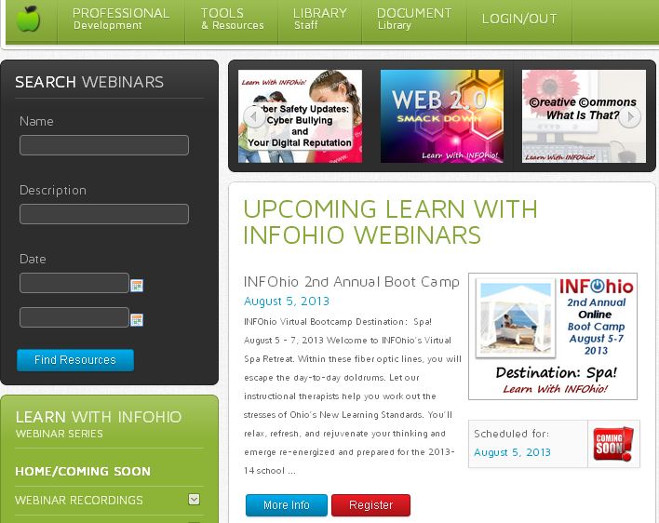
Webinars
CEUs available, even archived ones.
Search for a topic
What’s coming next
Archived webinars
Notes:
INFOhio webinars provide a wealth of information on a variety of topics of current interest to educators. You have the option of attending a live webinar or watching a recording at your convenience. At the end of the webinar, take a short quiz and print out a contact hour certificate.

Slide 15
2nd Annual Online Boot Camp
Keynote Speaker: Gwyneth Jones, the Daring Librarian.
Using Pinterest
Tools and Resources for College and Career Readiness
Common Core Instructional Shifts for English Language Arts/Literacy, Marcia Barnhart
AASL’s Lesson Plan Database
The Art of Judging Text Complexity and Selecting Resources
Work the Knots Out of Your Presentations
Curating with Symbaloo
Fun Ways to Get Students and Teachers to Love the Library
Notes:
Check out all our webinars including Bootcamp at http://educators.infohio.org/lwi

Slide 16
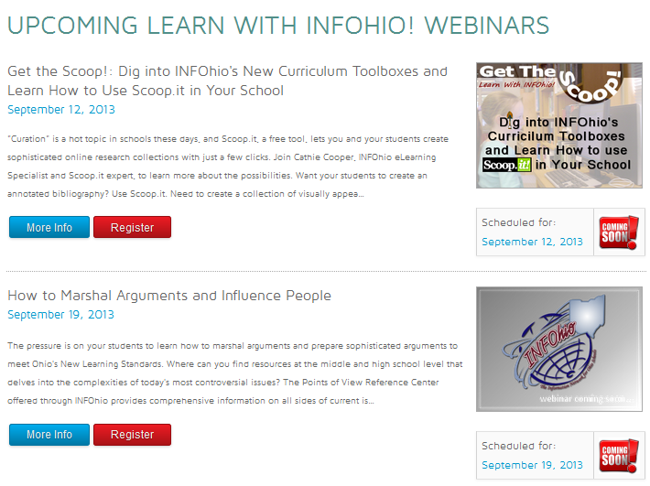

Slide 17
Remember: You can watch recorded webinars!
Yes, you can still get credit for them.
http://webinars.infohio.org

Slide 18
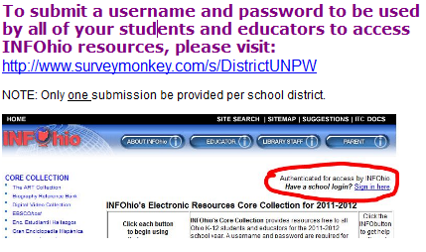
Electronic Resources
Do you have a unique school login?

Slide 19
2013 – 2014 Electronic Resources UN: infohio PW: power

Slide 20
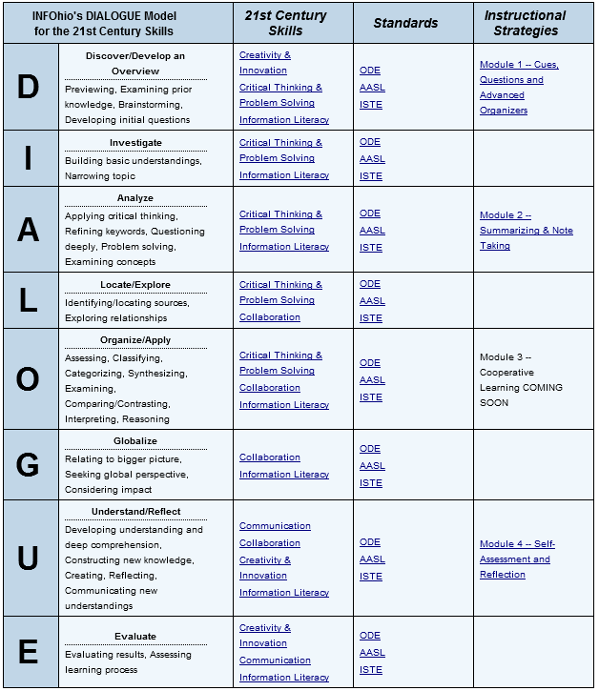
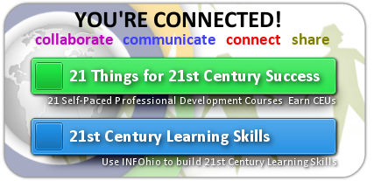
INFOhio User Council
Help promote an INFOhio initiative or to complete a survey
Meetings: October, February, June
October 16, 2013 (1-4PM) @ Kalahari Resort

Slide 21
INFOhio User Council
2012 - 2014 NEOMIN Representatives
Caroline Hines, Niles City Schools
Vacant ☹

Slide 22
INFOhio User Council
Want to be a Representative?
Term: Now until June 30, 2014

Slide 23
INFOhio Toolkit
Handout
http://www.infohio.org/toolkit
Bookmarks & Flyers
Common Core
Logos & Graphics
Presentations
Search Widgets

Slide 24
New Resources
Ebsco
Notes:
These are the new resources from Ebsco.
They have the same features as most Ebsco databases:
Create an account or use same for all databases
Create folders
Set alerts
Save, print, email
Persistent links – link to articles can be posted on webpages, blogs, etc.
Speech to text in HTML articles
Lexile level displayed in result list – NO searching by Lexile though in these.
Advanced search options to limit results by date, document type, publication, images, etc.
Citation help

Slide 25
More New Resources
Learning Express
World Book
Scholastic
Notes:
Workforce Skills is for older high school students. It goes beyond Job and Career Accelerator and stresses more practical workplace skills.
World Book Academic is the next level up from WB Advanced. It’s great preparation for college bound students.
BookFlix pairs fiction and nonfiction ebooks for younger students.

Slide 26
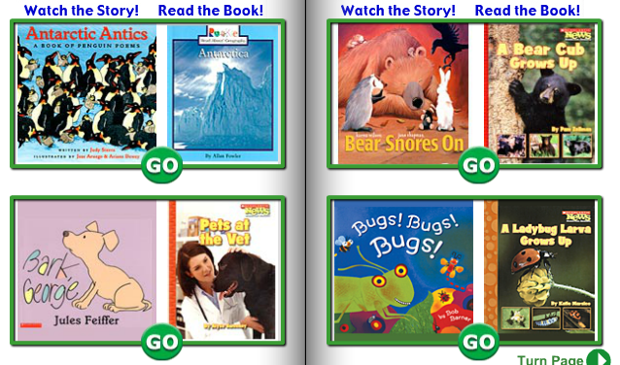
BookFLIX
Fiction and Nonfiction ebooks are paired.
Notes:
BookFlix is a literacy resource that pairs classic video storybooks with related nonfiction e-books to build a love of reading and learning.
110 fiction videos / nonfiction ebook pairs
32 Spanish pairs
Read along option
Educational games
Author biographies
Editor selected web links
Teacher resources

Slide 27
Research Tools for Students

Slide 28
Educator Tools and Resources

Slide 29
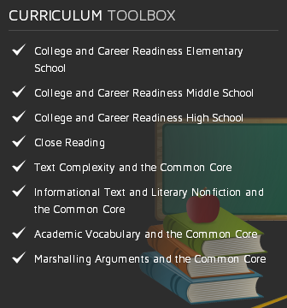
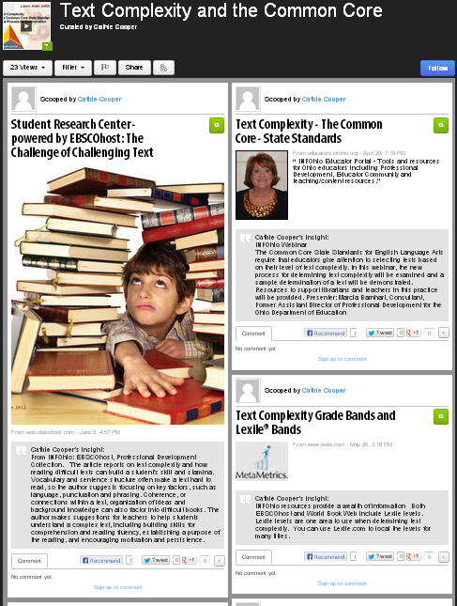
Curriculum toolbox
Currently this is on the INFOhio webpage – right side.
Scoop-its help with
Common Core focus areas
Notes:
The Curriculum toolbox contains Scoop-its divided into Common Core focus areas – college / career readiness, close reading, text complexity, information text, academic vocabulary, and marshalling arguments. Each area contains articles and resources to help educators implement the Common core. Readers can add comments, share on Facebook or Tweet.

Slide 30
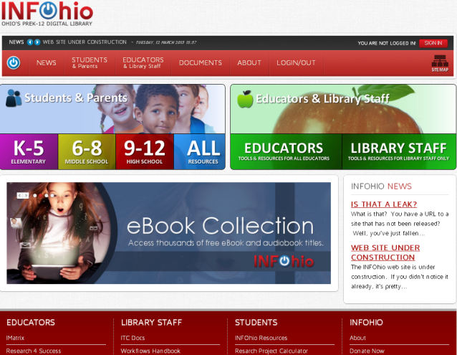
INFOhio’s New Website…

Slide 31
Questions, Concerns, or Comments?

