Slide 1
Webinar
March 22, 2012
3:30 – 4:30 p.m.

Slide 2
21st Century Learner
Notes:
I’d like to begin by giving you some background on why GO INFOhio was created. In 2007 American Associations of School Librarians issued Standards for the 21st Century Learner. The goal of these standards is to prepare students to be successful in the 21st century.
The focus of these standards is providing the learner with the foundation for lifelong learner. The standards also state that these skills are most effectively taught as an integral part of content learning and should not be taught in isolation. No more research classes. These ideas mirror those presented in the Common Core.

Slide 3
21st Century Learner Resources
Notes:
AASL created a few tools for school librarians to use as they work with students and teachers. These provide grade level examples, lesson plans, benchmarks and assessments.

Slide 4
New Common Core Standards
Notes:
Now let’s look at the Common Core Standards, another document created to prepare students for the 21st century.
Basically the Common Core gives educators a set of standards that provide a framework to prepare children for college and the workforce.
The Common Core State Standards is a state-led effort to establish a shared set of clear educational standards for English language arts and mathematics that states can voluntarily adopt. To date 46 states have adopted the Common Core including Ohio (2010)
The standards were designed by a diverse group of teachers, experts, parents, and school administrators not only to ensure that students graduating from HS are prepared to go to college or enter the workforce but also that parents, teachers and students have a clear understanding of what is expected of them.
The standards are benchmarked to international standards to guarantee that our students are competitive in the global marketplace.
The CC standards don’t provide a complete scope and sequence or a course outline of all the skills and knowledge students could have. What they do is outline the most important essential skills and knowledge every student needs to master to succeed in college and careers.
The Common Core defines information literacy as a critical skill for the 21st century.

Slide 5
Question:
Within the context of writing, researching, and information literacy, what strengths and weaknesses do your first year students come to you with?
Asked of 1st year writing faculty
Notes:
Are the new Common Core standards needed? Let’s look at the results of a recent study done at Cleveland University where professors of freshmen were asked this question.

Slide 6
Answer:
What I often see in my students?
An unwillingness to read carefully,
A general lack of curiosity,
And an approach to research that goes like this: The first three hits on Google (Wikipedia usually front and center).
Notes:
The answers show why the Common Core standards are needed.

Slide 7
Answer:
Most college students are not good at recognizing research-worthy sources from non-research worthy sources.
Notes:
I don’t think these answers surprise us.
With schools across the country implementing the Common Core, hopefully the answers to these questions will be very different in the future.

Slide 8
English LA Common Core Standards
Four strands: reading, writing, speaking & Listening, language
Each strand has set of Anchor or College Career Ready Standards
Aligned and increase in complexity
Notes:
There are four strands in the Eng LA Standards.. Each stand has a set of anchor standards that each child should know. Then these branch off into specific statements for each grade level. Together the anchor and grade level specific statements define the skills and understandings that all students must demonstrate.
Research and media skills blended into the Standards as a whole.
The importance of research is emphasized in the introduction to the Common Core:
“To be ready for college, workforce training, and life in a technological society, students need the ability to gather, comprehend, evaluate, synthesize, and report on information and ideas, to conduct original research in order to answer questions or solve problems, and to analyze and create a high volume and extensive range of print and non-print texts in media forms old and new.” Because of this belief research and media skills are integrated throughout the standards and not treated as a separate section.
Example: Gr 6- 8 reading standard for history & SS requires students to analyze the relationship between a primary and secondary source on the same topic
Gr 9 -10 reading standard in science and technology that asks students to compare and contrast findings presented in a text to those from other sources

Slide 9
Literacy Standards
Grades 6 – 12in History Social Studies, Science and Technical Subjects
Shared responsibility within the school
Increase in amount of research including short and frequent projects
Notes:
Literacy Standards in History/Social Studies, Science and Technical Subjects
Starting in grade 6, the reading and writing standards are divided into two sections, one focusing on Eng and LA, and the other focusing on history/social studies, science and technical subjects. What this means is that all teachers not just the English teacher but all teachers share the responsibility to teach the reading, writing, speaking, listening and research skills.
Two major shifts seen as OH moves from the state standards to the Common Core: - One is the increased amount of research both small and large projects required in all subject areas
-Two - the responsibility for all teachers to teach literacy.
So research is no longer to be taught in isolation or as a 9th or 10 grade research paper or project. The new expectation is that students in grades 6 through 12 will have many opportunities to engage in short research projects in many subject areas.

Slide 10
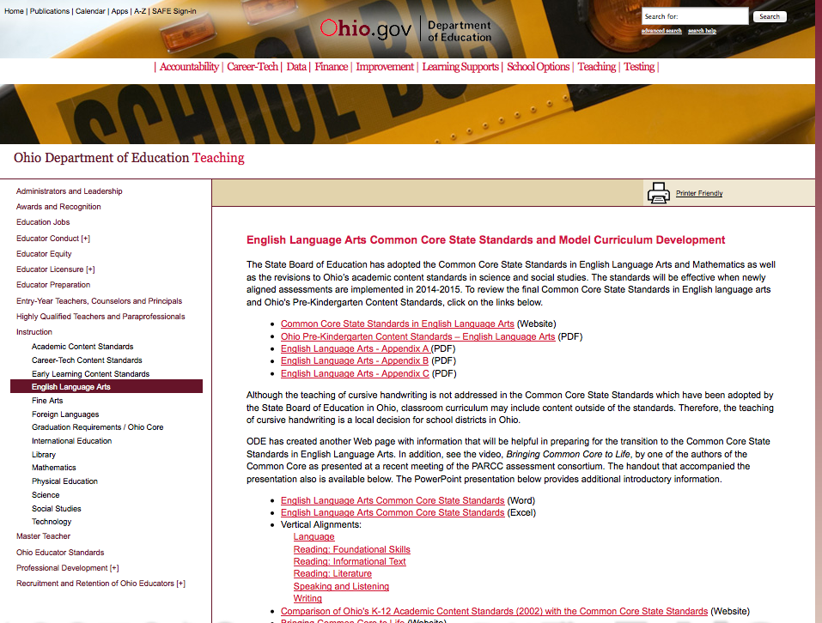
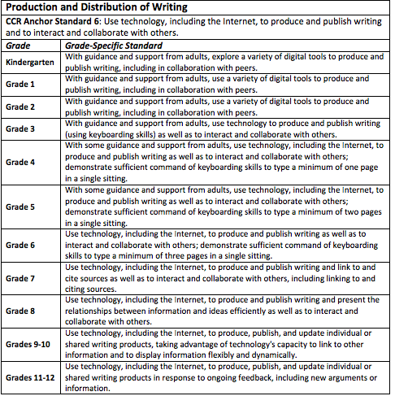
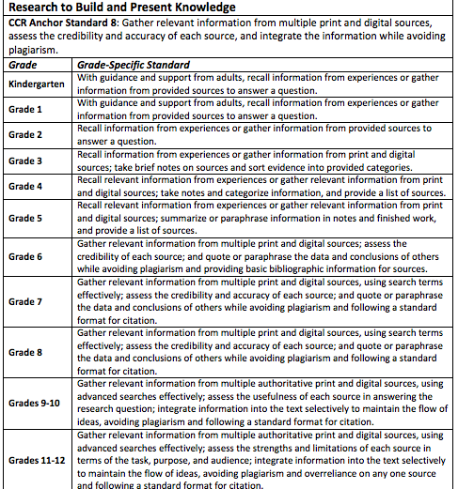
New Common Core Standards
Common Core Standards:
ELA Vertical Alignments
http://education.ohio.gov
Notes:
These vertical alignments from the English Language Arts Common Core demonstrate the research strands in the Writing standards. Notice the scaffolding that occurs from one grade level to another.
In the Writing strand research is very important. Both short, focused projects such as those commonly required in the workplace as well as larger research projects are emphasized.
For example, if we look at anchor standard 6: Use technology, including the Internet, to produce and publish writing and to interact and collaborate with others we see that at
- 4th grade students are to use technology including the internet to produce & publish writing as well as interact & collaborate w others
at 8th grade the ability to present the relationships between information and ideas effectively is added
by the 9th & 10th grade students must produce & publish and also update individual or shared writing products taking advantage of technology’s capacity to display information flexibly & dynamically
In Ohio implementation of the Common Core has begun. This year K-2 students should be working with the standards. Full implementation should be in place for all grade levels during the 2013 -2014 school year.

Slide 11
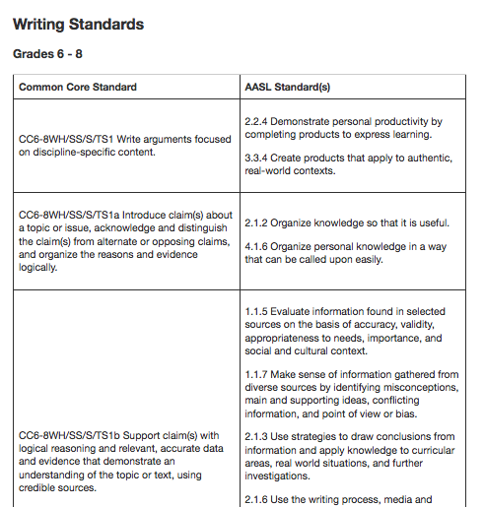
Common Core Crosswalk: Common Core to AASL
www.ala.org/aasl/guidelinesandstandards/commoncorecrosswalk
Notes:
Another tool that might assist you as you work on the implementation plan is the Common Core Crosswalk. The Crosswalk was developed to help school librarians and teachers implement both the Common Core and the AASL standards,

Slide 12
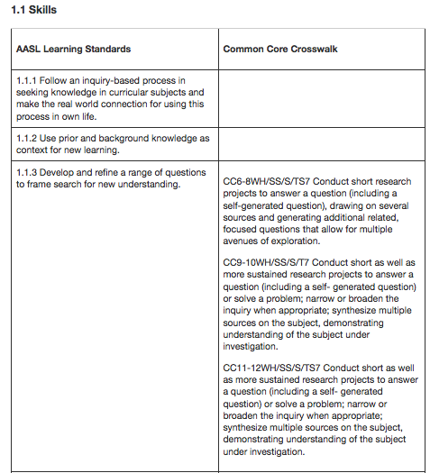
Common Core Crosswalk: AASL to Common Core
www.ala.org/aasl/guidelinesandstandards/commoncorecrosswalk
Notes:
This Crosswalk and the other tools developed by both the AASL and ODE are available to assist you as you implement the Common Core standards in your school.

Slide 13
New Common Core Standards
Notes:
GO INFOhio breaks the research process down into three major steps: Ask—ACT—Achieve. Each phase asks key questions that link students to INFOhio resources, forms, and relievable websites.

Slide 14
New Common Core Standards
Asking the Right Questions
Ask helps students get started with their research.
Notes:
Ask helps students get started with their research.

Slide 15
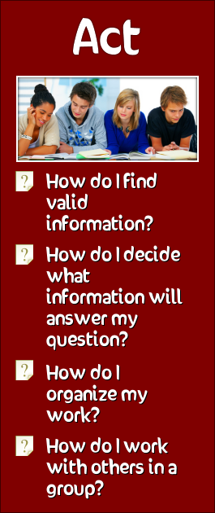
New Common Core Standards
Taking Appropriate Action
Act helps students find and organize information, either alone or in a group.
Notes:
Act helps students find and organize information, either alone or in a group.

Slide 16
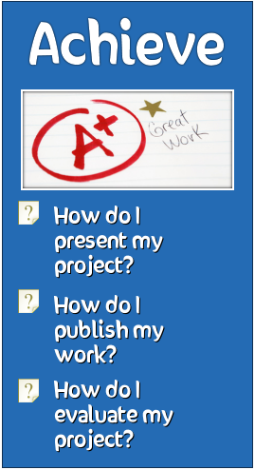
New Common Core Standards
Achieving Results
Achieve helps students create and present the results of their research.
Notes:
Achieve helps students create and present the results of their research.

Slide 17
New Common Core Standards
Notes:
Students may start at any point on the GO website for assistance with their research. The Go! Research process begins with determining a topic. This presentation begins with topic construction in ASK and moves through information gathering in Act and then producing a final product in Achieve.

Slide 18
New Common Core Standards
Lets Get Started
Notes:
The Kent State University Libraries TRAILS assessment demonstrates that students across the nation have a difficult time constructing topics. Go! Assists students in topic construction by taking them through three steps prior to finalizing a topic…Surveying topic choices, determining background information and then making choices on where to begin research.

Slide 19
Notes:
Determining a topic provides several forms and sites that help a student think through the initial stages in topic development including initial topic ideas, narrowing the topic to a small enough topic to research (this is the place most students have difficulty) and organizing subtopics.

Slide 20
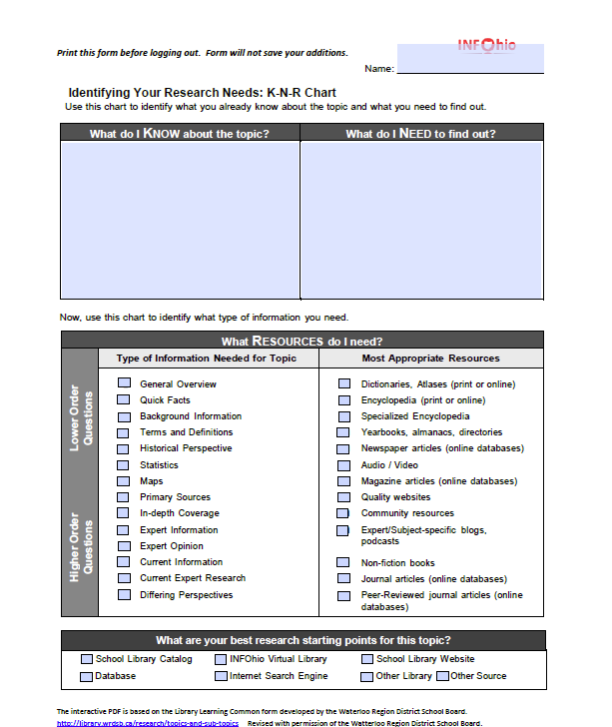
New Common Core Standards
Interactive PDFs
Type Here…
And Here…
And Here.
Then Print!
Notes:
The PDF’s within the GO! Site are interactive. This means that a student may download the PDF and type right on the PDF then print it. The PDF’s will not save the information. So students must type and print all at one time. If there are not enough computers, the PDF”s may be downloaded and printed for students to work with a pen and paper.

Slide 21
Notes:
“What do I already know?” provides students with two interactive PDF’s to assist in charting out what a student knows, want to know and questions they will ask to help them in research. Part of the topic development process is determining questions. Often the questions become a researchable topic – which would take the student back to the “how do I decide a topic?” section to further develop the topic. Again, the research process is not linear and may include revisiting sections of the Go website.

Slide 22
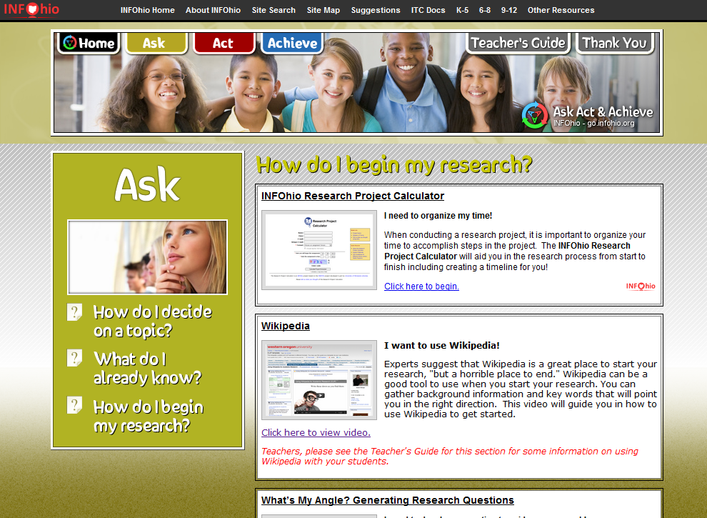
Notes:
“How do I begin my research?” focuses on first steps in organizing research. In this section the student determines a timeline to complete the project on time, generates research questions, identifying keywords to allow deeper thinking and research, organizing research questions with identified resources, and determining how to best use Boolean logic when researching. We all know students use Wikipedia, even if we direct them not to. So, in GO! INFOhio, we have placed an appropriate use of Wikipedia in the research process.

Slide 23
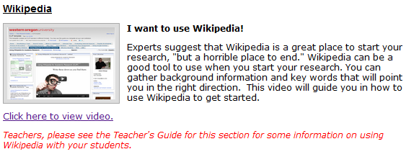
New Common Core Standards
Using Wikipedia
Notes:
Wikipedia is presented as a place to begin research to assist with finding keywords and commonly known background information. Wikipedia should not be cited as a source. There is additional information on appropriate use of Wikipedia in the Teachers’ Guide with some tools to help teachers work with students to move beyond Wikipedia to sources with deeper information.

Slide 24
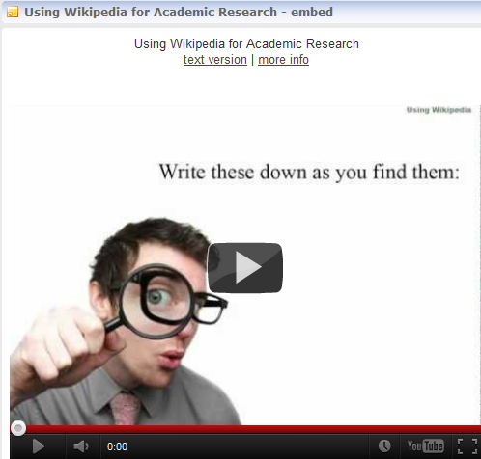
New Common Core Standards
Using Wikipedia
Notes:
Let’s take a look at the video. Click the link to begin the video. The video is in YouTube. If you think there will not be YouTube access, download the video prior to the presentation.

Slide 25
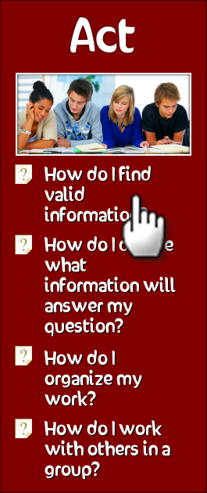
New Common Core Standards
But wait…there’s more.
Notes:
The Act section helps students with their actual research once they have defined and refined their question. This section is divided into 4 questions covering finding information, evaluating information, organizing resources and working in a group.

Slide 26
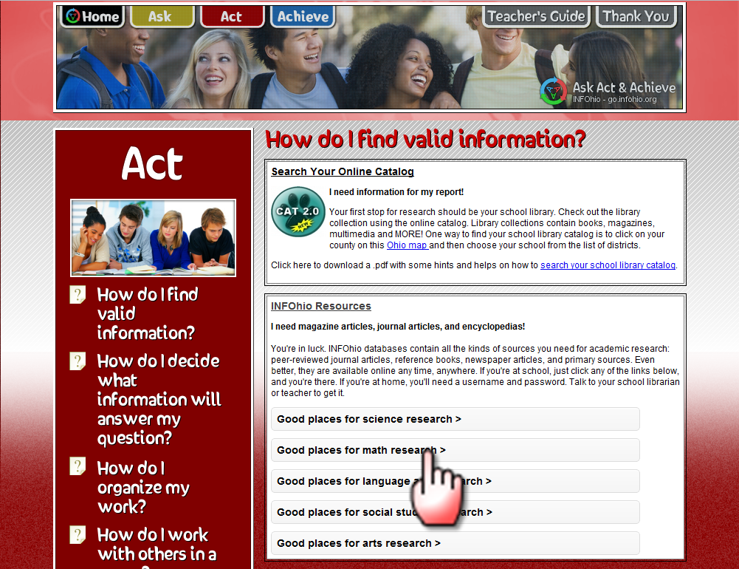
Notes:
In addition to web resources and templates, we have included the INFOhio databases you’re already familiar with. The INFOhio resources are conveniently divided by subject areas.

Slide 27
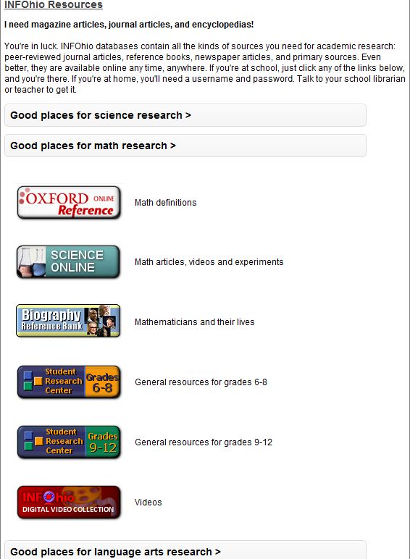
New Common Core Standards
Introducing the Accordion
Notes:
Here you see the math resources unfolding for students to easily identify and use. The resources for each subject area open in accordion fashion.

Slide 28
New Common Core Standards
Highlighted Resource: Behold
Notes:
Because it is so important to teach digital citizenship and the use of Creative Commons licensed images in presentations, we have included the search engine, Behold to find those appropriate images. When searching for images you can check that you want images that are free to use and licensed to modify as well. The Behold search engine provides a very user-friendly image search.

Slide 29
New Common Core Standards
Highlighted Resource: Purple Planet
Notes:
Another important aspect of digital citizenship and copyright is teaching students what music they can legally use for their projects. The Purple Planet site is in the ACT section too. It organizes legal instrumental music by the themes of calm, tense, sadness, mystery, comic and even horror. Students can download and save entire themes or short pieces to use for transitions.
I have linked to a short piece from the tense category called Turning the Screw.
In addition to these resources, we have included a resource from NoodleTools on Choosing a Search Engine, Asking Experts, and links to the Apps for the INFOhio resources.

Slide 30
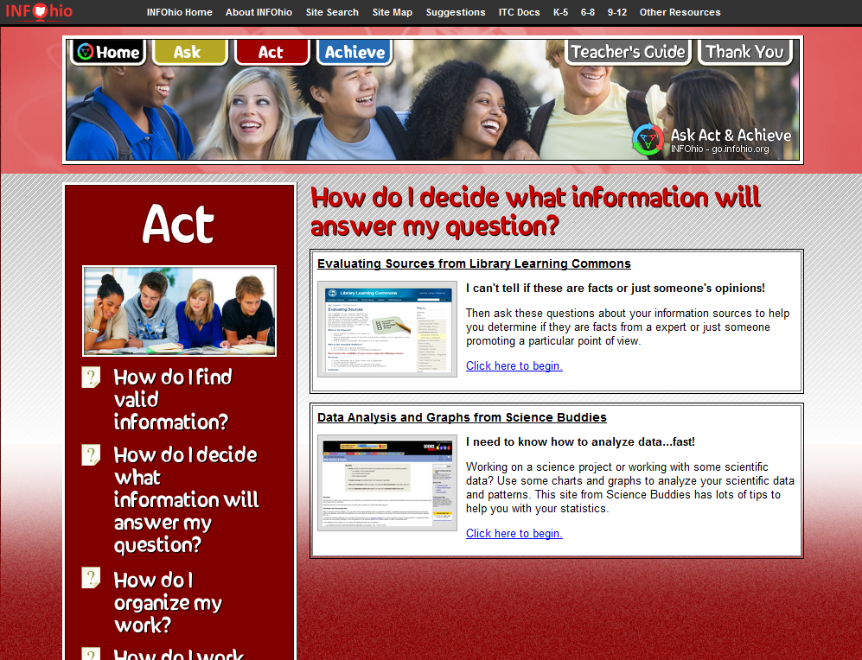
Notes:
The second question in the Ask section, How do I decide what information will answer my questions contains sources to help students evaluate their information. The Data Analysis and Graphs resource can help them evaluating their own data that they might want to enter for a science or math project.

Slide 31
Notes:
In this section we have assembled some Web2.0 tools and traditional paper and pencil resources to help students organize their work. For example, there is a section to help students use notecards and also resources on using the online notetaking tool, Evernote, which is often listed as a tool students should use for college and careers. Diigo and EBSCO folders are linked here to help students bookmark their project resources, while Dropbox, iGoogle and Google Reader give students advanced options to collect and organize resources.

Slide 32
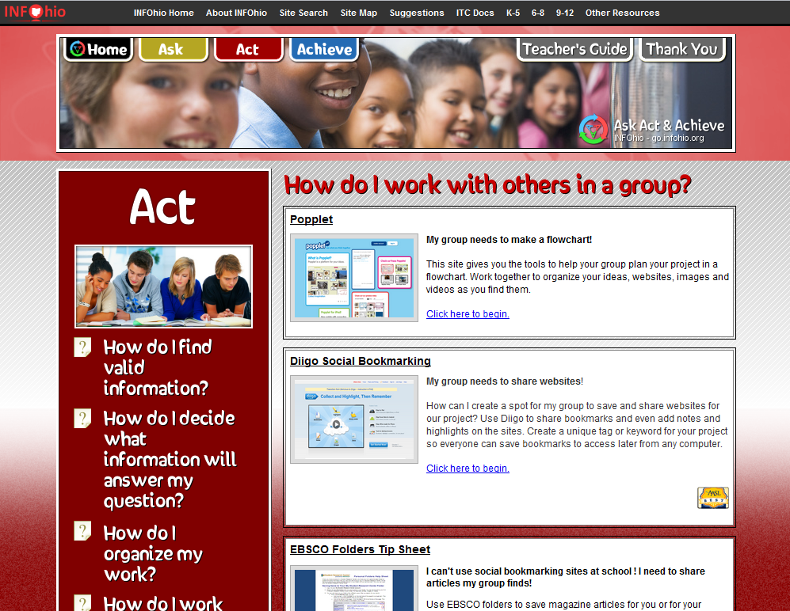
Notes:
We think the resources collected in the “How do I work with others in a group?” section will be very useful for the collaborative projects required by the new Common Core writing standards for Literacy in History/ Social Studies, Science and Technical Subjects.
CCR Anchor Standard 6 requires students to “Use technology, including the Internet, to produce and publish writing and to interact and collaborate with others.”
Some of the resources collected here are Popplet for creating a collaborative flow chart of a project with even images and videos. We also link to Diigo for group bookmarks, using Google folders for group work, and organizing group work with Wikispaces and Google Docs.

Slide 33
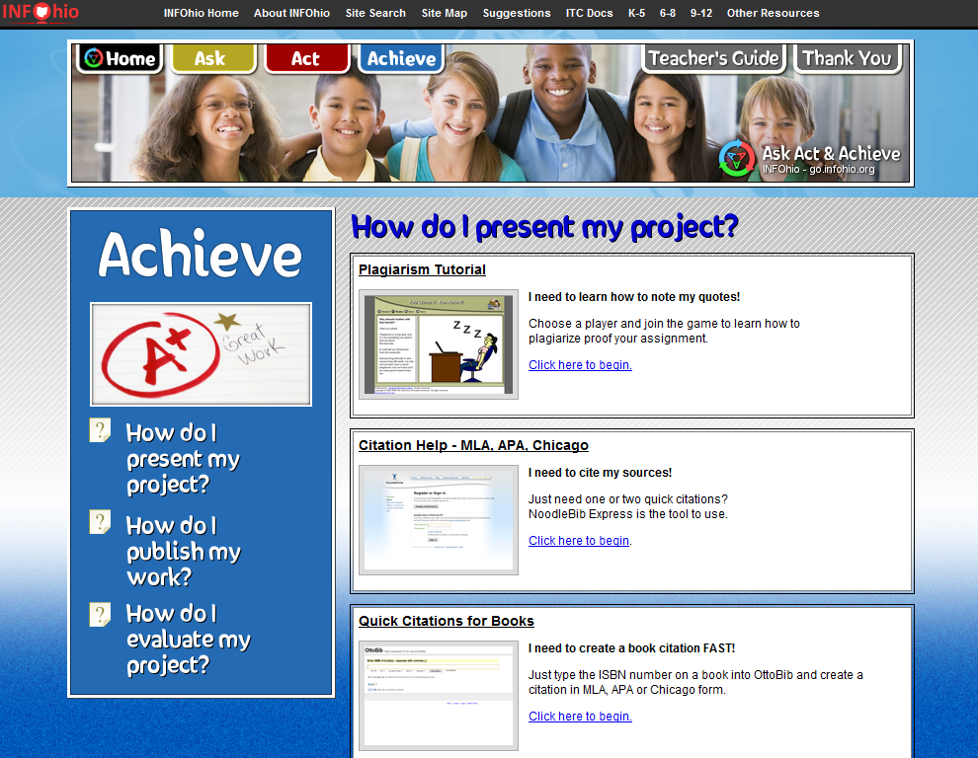
Notes:
The Achieve section of Go! Focuses on presentation, publication and evaluation of a students research. In “How do I present my project?” the student is directed to first consider how and when to cite sources. The citation information includes directions on creating citations when using Microsoft word for a formal research paper. As you scroll down this section students are introduced to a variety of freely available web-based presentation tools such as Wordle (a word graphic tool), creating a wiki with Wikispaces, creating a digital story with Animoto, creating a multimedia presentation with VoiceThread and with PowerPoint, creating a timeline with Dipity, creating an online video with Masher, and creating a poster with Glogster. The teacher’s guide contains many additional online presentation tools that can be introduced to students as they work on their research project.

Slide 34
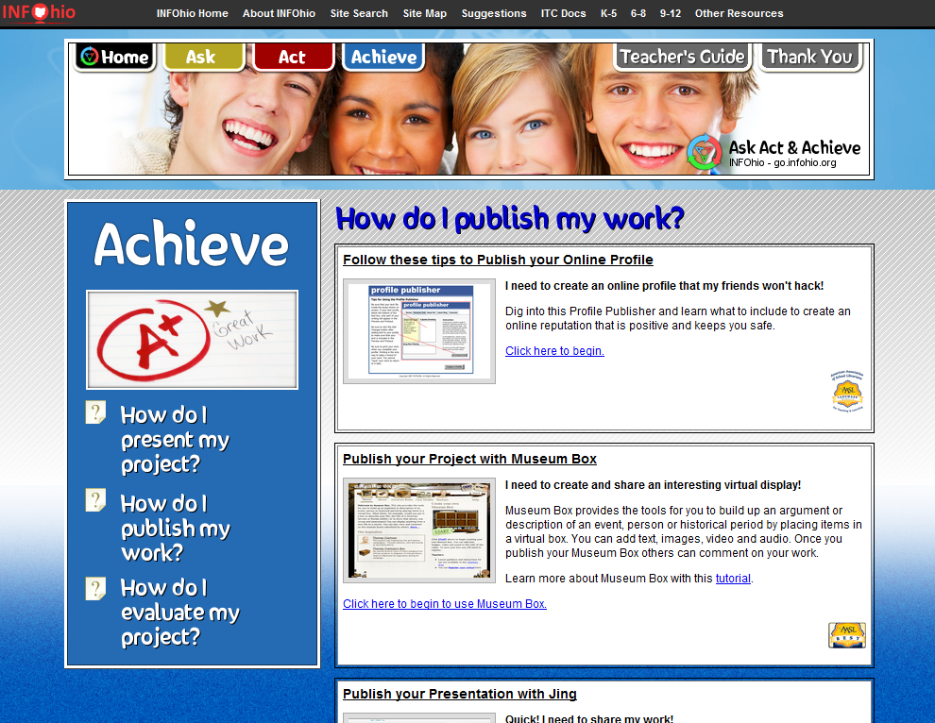
Notes:
“How do I publish my work” begins with a focus on creating a positive online profile and emphasizing that anything you publish becomes part of your online profile. The tools presented in this section allow students to freely publish their project to share with others. Again just a few resources are presented in this section. Many more are presented in the teachers guide. The tools included are Museum Box which allows a person to build an argument or description, a focus of the English Language Arts Common Core; Jing, a screen capturing, recording tool; SchoolTube, a video publishing tool; Google Sites, a web authoring tool; SlideShare, a PowerPoint publishing tool; Issuu, a document publishing tool. Each of these tools allow publication without cost to the student or school.

Slide 35
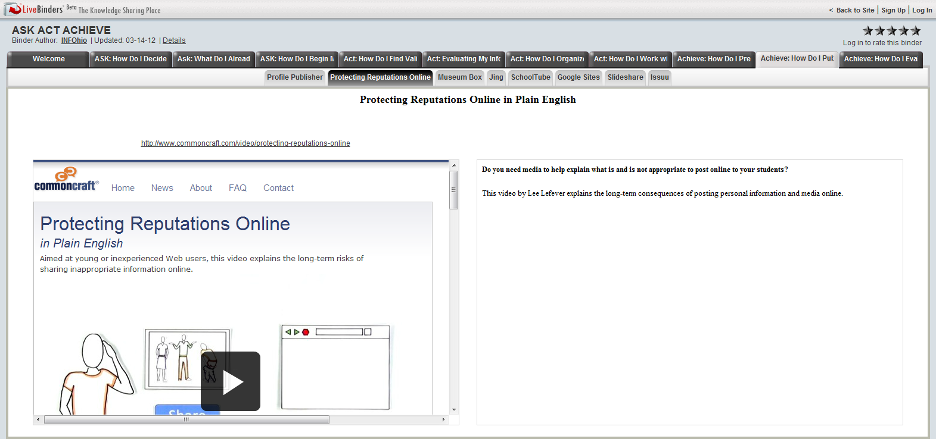
New Common Core Standards
Achieve-How Do I Publish My Work?
Notes:
Again, the focus of “How Do I Publish My Work” is on protecting your online reputation. The Teacher’s Guide has many resources and tools to assist in instructing students in how to protect your online reputation. This video from Commoncraft provides information for both students and teachers. (Play the video if you have time).

Slide 36
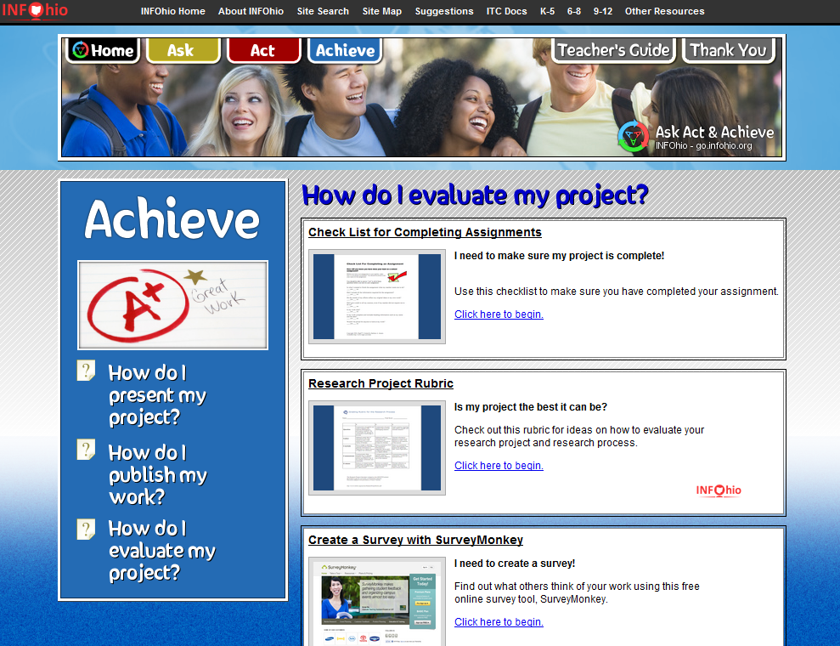
Notes:
“How do I evaluate my project?” guides students through ways to reflect on their research including techniques such as using check lists to make sure the assignment is complete and ways to quickly survey others to find out reactions to the work. The final evaluation is a step that is often overlooked and can make a big difference in long term learning from the research process.

Slide 37
New Common Core Standards
The Icons
INFOhio Resource
AASL Best Website for Teaching & Learning
AASL Landmark Website
Notes:
Throughout the Go! Site you will find these icons which identify sources that are provided by INFOhio or are recognized by AASL as outstanding resources.

Slide 38
New Common Core Standards
Nifty Features

Slide 39
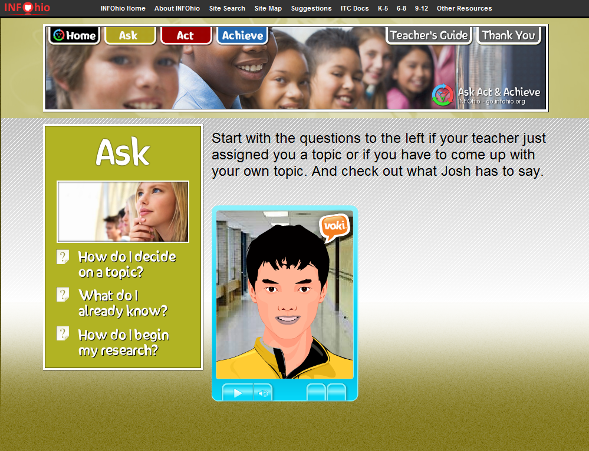
New Common Core Standards
Meet Josh
Notes:
Each section is introduced by a Voki (avatar) with a student voice. Meet Josh to tell us about the Ask section.
(If you click on the arrow to play the browser will go to the Ask intro page. Then click on the play arrow and Josh will introduce the section.)

Slide 40
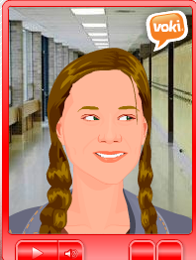
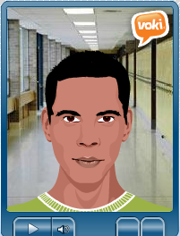
New Common Core Standards
And Hannah and Luke
Notes:
Hannah will introduce the Act section and Luke, the Achieve section. Students from Gahanna Lincoln High School and Gahanna Middle School provided the voices.

Slide 41
New Common Core Standards
Teacher’s Guide
Notes:
There is a link on the GO page to the Teacher’s Guide section.

Slide 42
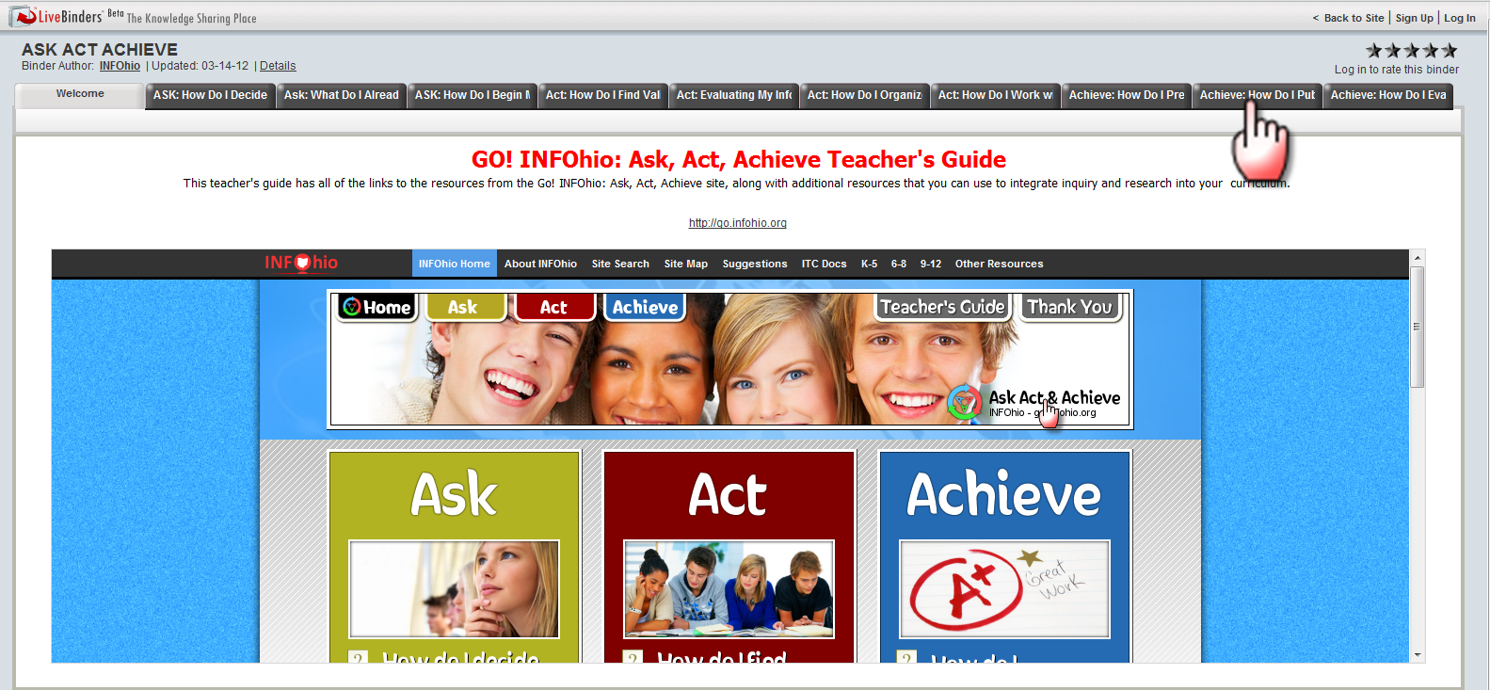
New Common Core Standards
Teacher’s Guide
Notes:
This section is a LiveBinder which corresponds to each section and resource from the GO! INFOhio site. All of the resources and tools from GO! INFOhio are here, along with extra tips for teachers, videos and some additional handouts. For example, in the ASK section, the Wikipedia section has an article on why we need to teach about Wikipedia.

Slide 43
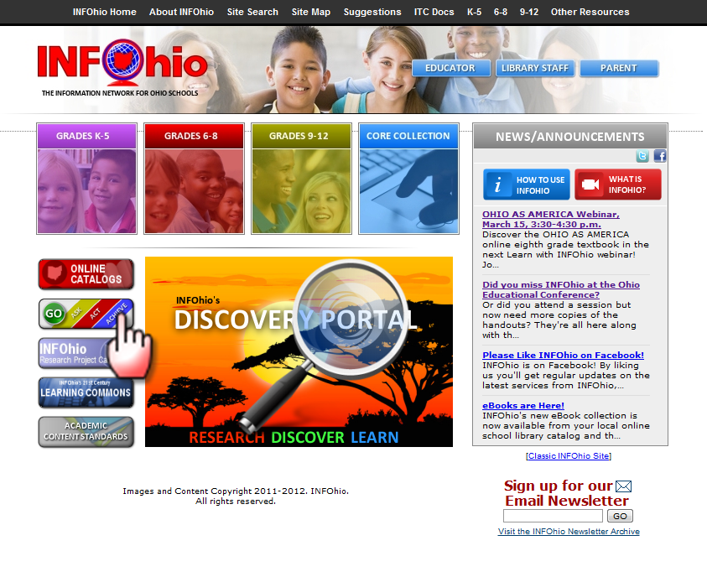
New Common Core Standards
How Do I Get There?
HTTP://GO.INFOHIO.ORG

Slide 44
New Common Core Standards
How Do I Tell People About GO!?
INFOhio Home Page
About INFOhio
Document Library
Or in Teacher’s Guide
Notes:
The flyers on Go, including the one page document which lists all of the resources in each section, can be found in the INFOhio Document Library under About INFOhio on the INFOhio Home Page. You can also find both documents in the Teacher’s Guide under the Useful Documents tab on the far right. We will be adding other documents on how the tools on this site can be used to help meet the requirements for teaching inquiry in the Common Core standards.

Slide 45
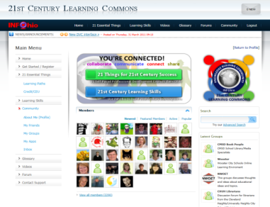
New Common Core Standards
Where Can I Learn More?
It’s As Easy As 1-2-3
1. Go to INFOhio’s Learning Commons, create an Account, and log in.
Access Community from top of page or sidebar on left. This is the KBC, Knowledge Building Community.
Join the Inquiry and the Common Core Group. (From the link at the top for Community, choose Groups, then All Groups. Then join, share and learn!)
Notes:
Please join the discussion group, Inquiry and the Common Core, in INFOhio’s Knowledge Building Community, KBC. The KBC is a social network for educators which is not blocked in your schools, because it comes from INFOhio. We hope teachers and librarians will discuss how they are using the GO! INFOhio site in the classroom and even share students work. We encourage educators to make suggestions here on resources that should be added to this site as well. We look forward to hearing from you in the KBC. Please join and share!

