Slide 1
Infographics
Using images to make information & data visually appealing

Slide 2
why?
Easier to read
Faster to read
Memorable

Slide 3
or

Slide 4
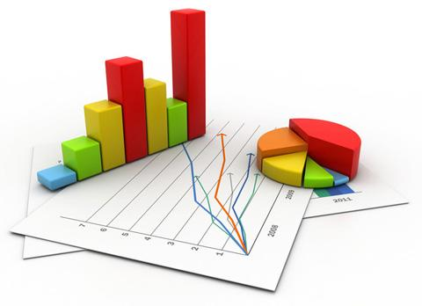
what?
Statistics
Surveys
Reports
Lists
Brochures

Slide 6
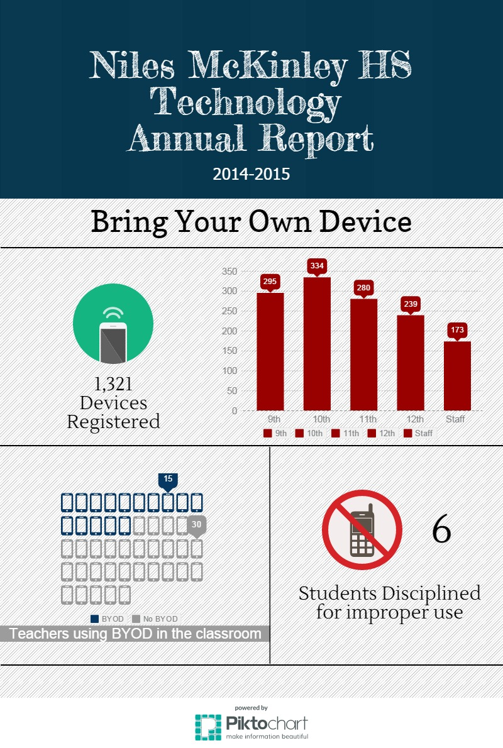
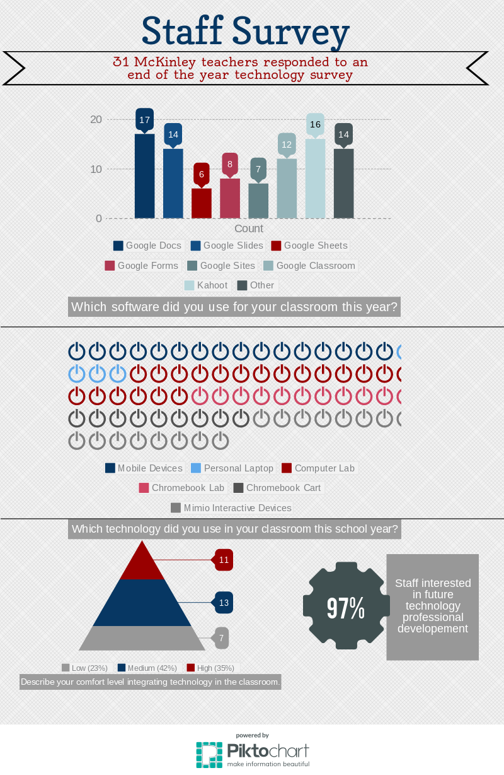
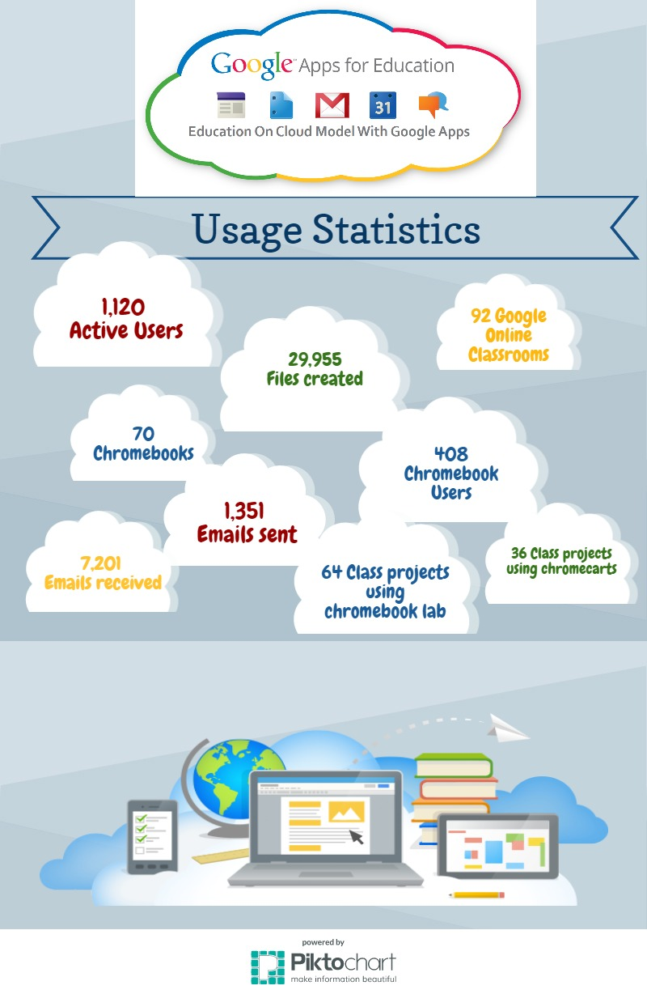

Slide 7
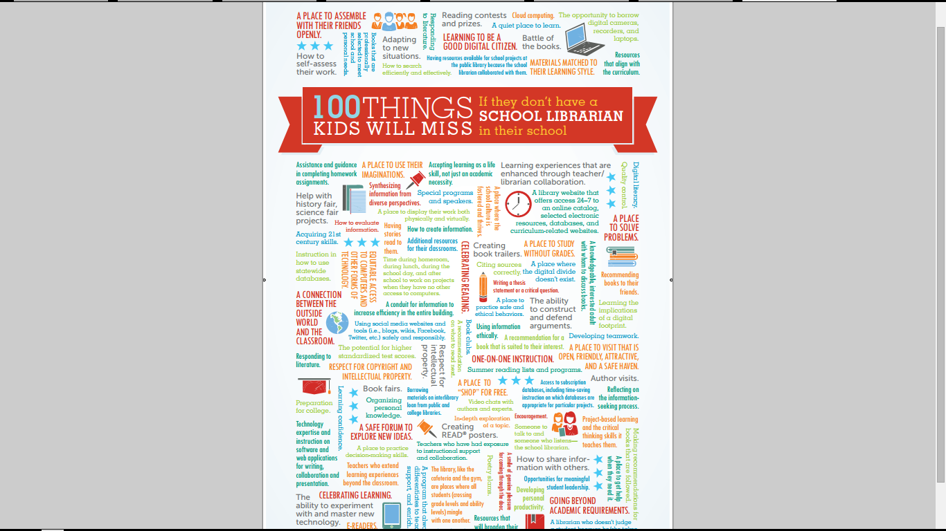

Slide 9
how?
https://www.canva.com/create/infographics/
https://infogr.am/
https://venngage.com/
http://piktochart.com/
http://www.easel.ly/

Slide 11
with students...
Comparisons
Surveys
Reports
Lists

Slide 12
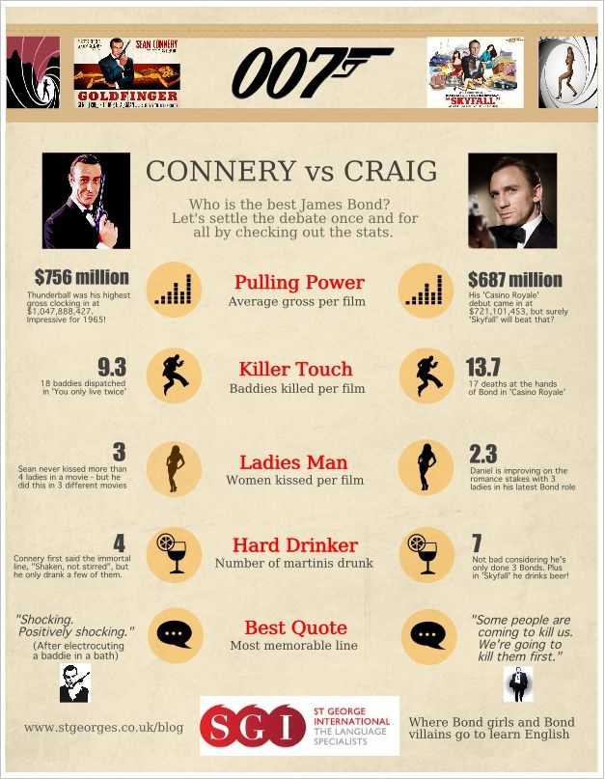

Slide 15
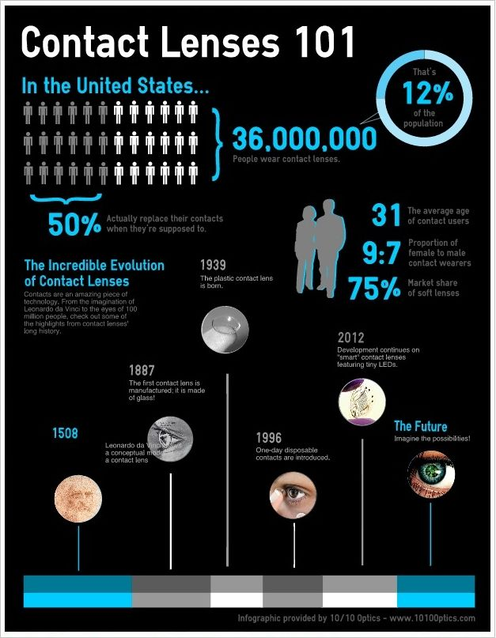

Slide 16
