Slide 1
2023
USPS-R Calendar Year End Review
NEOMIN

Slide 2
Pre-W2 Processing-OSDI
•OSDI abbreviations **IMPORTANT-REQUIRED** for proper reporting on W2.
–Include OSDI code number and district name in the W2 Abbrev field on the School District Payroll Item Configuration record

Slide 3
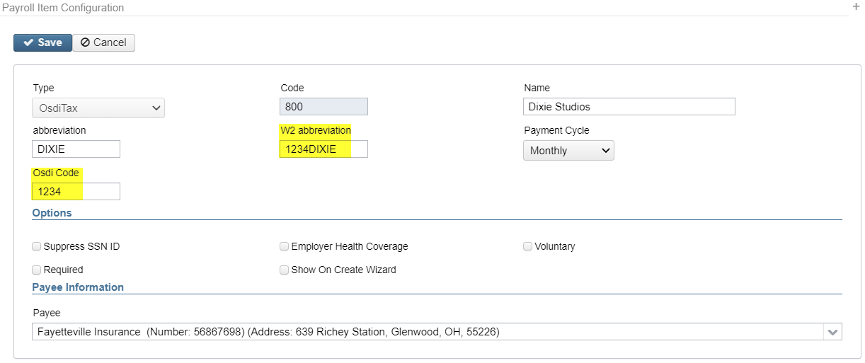
Pre-W2 Processing-OSDI (continued)
Payroll Item Configuration

Slide 4
Pre-W2 Processing-City
•Verify ‘Entity code’ in Payroll Item Configuration is completed for any electronic reporting to any city.

Slide 5
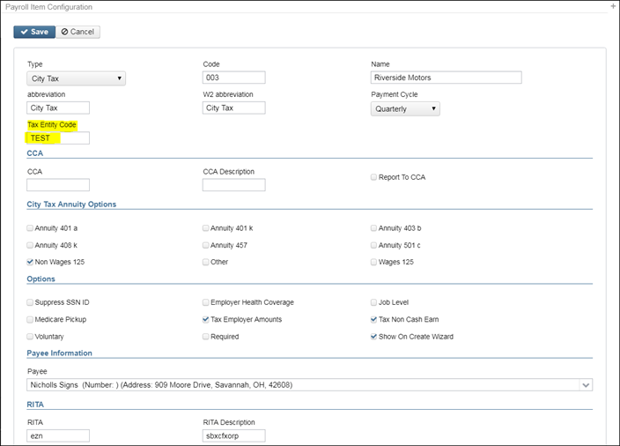
Pre-W2 Processing-City (continued)

Slide 6
Pre-W2 Processing-CCA/RITA
•CCA/RITA Reporting
–Verify values in Payroll Item Configuration are set
–RITA/CCA codes are required for tax data to be included on a submission file
•See information from RITA/CCA web sites on codes as defined

Slide 7
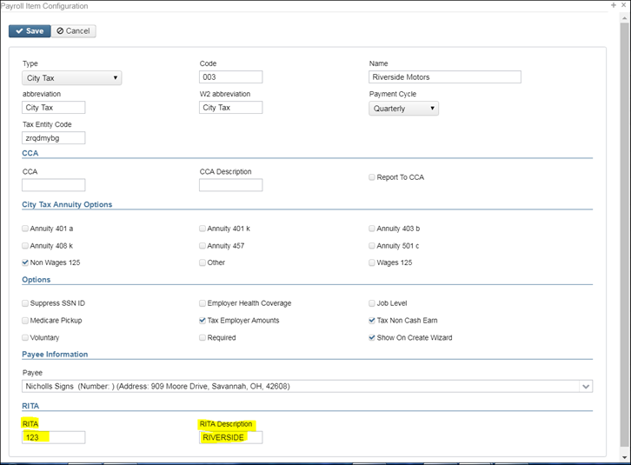
Pre-W2 Processing-CCA/RITA (continued)

Slide 8
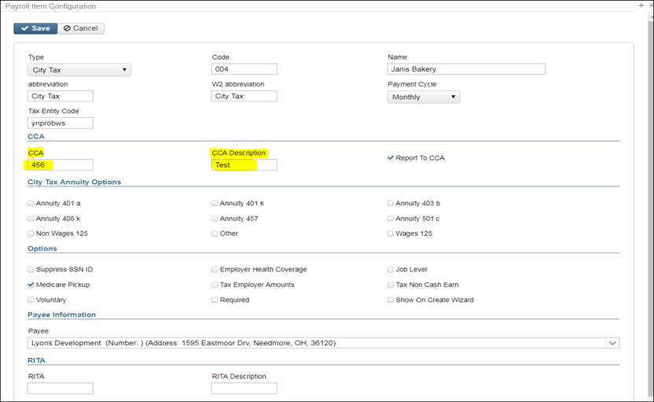
Pre-W2 Processing-CCA/RITA (continued)

Slide 9
Pre-W2 Processing-CCA/RITA (continued)
Verify Payroll Item “Deduction Type” value must be on all city Payroll Item records that report to CCA or RITA
Is this city tax record required because of the employees place of:
Employment or Residence
Use Core>Payroll item & Advanced Query (go over this)
See the following web sites for complete details regarding C-Employment and
R- Residence reporting for RITA and CCA:
–https://www.ritaohio.com/Businesses/Faqs?category=B&subcategory=Employer%20Withholding
–http://ccatax.ci.cleveland.oh.us/?p=faq

Slide 10
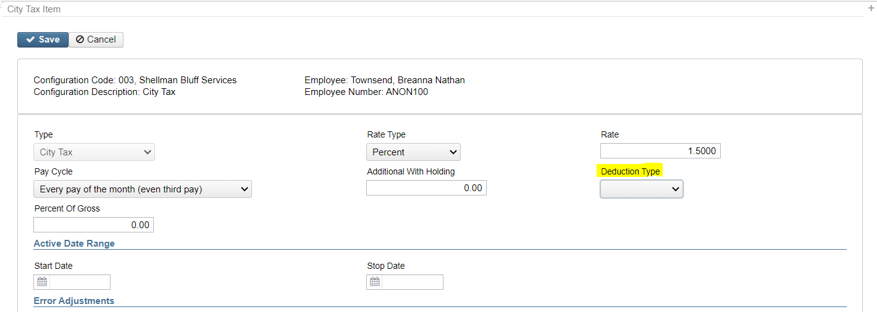
Pre-W2 Processing-CCA/RITA (continued)
Payroll Item Record-
Deduction Type-Employment or Residence

Slide 11
CCA Addresses
Want to make sure the addresses are correct for CCA reporting or may have issues
Have your districts verify that they adhere to the USPS Standards
https://pe.usps.com/text/pub28/welcome.htm

Slide 12
CCA Setup
CCA RS records-RS (State) Record Overview Each employee in a W-2 dataset will have State tax information with possible unemployment compensation. In addition, the employee may have applicable Municipal tax information. The purpose of the RS (State) record is to report the State and Local tax information for an employee.
http://ccatax.ci.cleveland.oh.us/forms/dataformat2020.pdf
Districts must have CCA set up accordingly:
* If CCA city is in Appendix A, they need the following in Payroll Item Configuration for CCA: ‘Report to CCA’ flag = Y, valid CCA code and valid CCA City Description.
* If CCA city is not in Appendix A but in Appendix B, they need the following in Payroll Item Configuration for CCA: ‘Report to CCA’ flag = blank, valid CCA code and valid CCA city name.
* If CCA city is not in Appendix B or C, they need the following in Payroll Item Configuration for CCA: ‘Report to CCA’ flag = blank, CCA code = blank and valid CCA city name found in OHIO Municipal Income Tax Rate Table

Slide 13
CCA Setup
Then they need to look on the https://thefinder.tax.ohio.gov/StreamlineSalesTaxWeb/Download/BoundaryData/Muni/OHMuniRateTable.csv spreadsheet and enter the city name in the CCA Description field. This is for ALL cities, not just CCA.

Slide 14
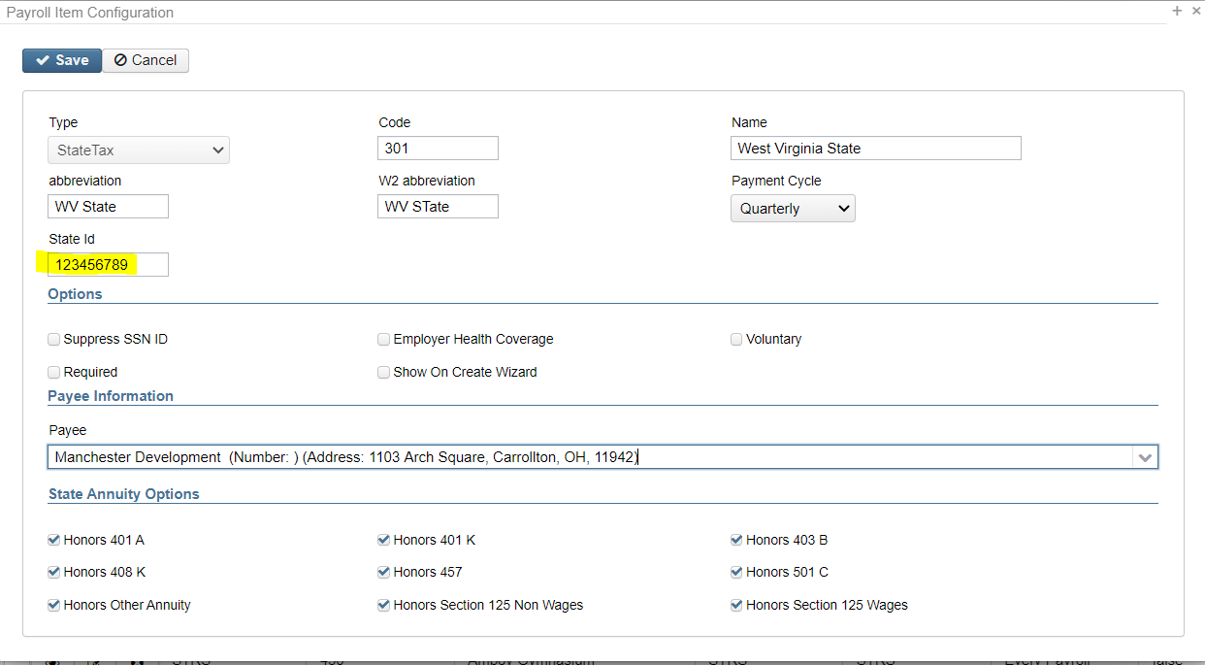
Pre-W2 Processing-State Tax
Payroll Item Configuration Record-
Make sure PA State Tax has the
appropriate State Id populated on the Payroll Item Configuration record-

Slide 15
Pre-W2 Processing-HSA
•Health Savings Account (HSA)
–Annuity Type on the Payroll Item Configuration must be set to “Other” even if there are no employee amounts withheld

Slide 16
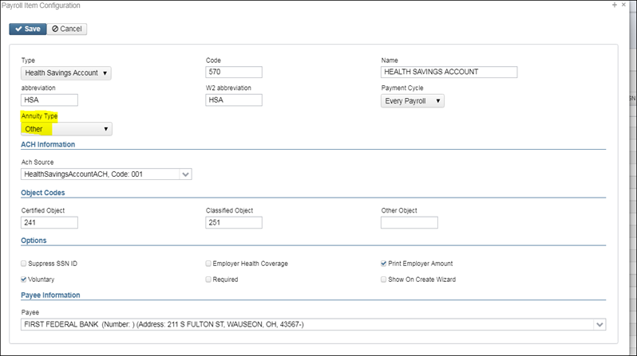
Pre-W2 Processing-HSA (continued)

Slide 17
Pre-W2 Processing Taxable Benefits (NC3)
Use the 'Non-cash Taxable Benefit' pay type in Payroll Payments CURRENT or FUTURE and this will represent the non-cash taxable benefits amount (NC3)
If the 'Non-cash Taxable Benefit' pay type was not used during payroll processing, an Adjustment entry is needed using the Taxable Benefits. This will update the total and taxable gross totals on the Federal , State, City (If applicable) OSDI and Medicare records during W2 Report. If the Medicare withholding was paid by the employee (1.45%) and employer (1.45%), adjustments must be made to the Amount Withheld and Board Amount of Payroll Item. If Medicare is fully board paid (Pickup), then the total Adjustment should be made to the Board's Pickup Amount of Payroll Item (2.90%)

Slide 18
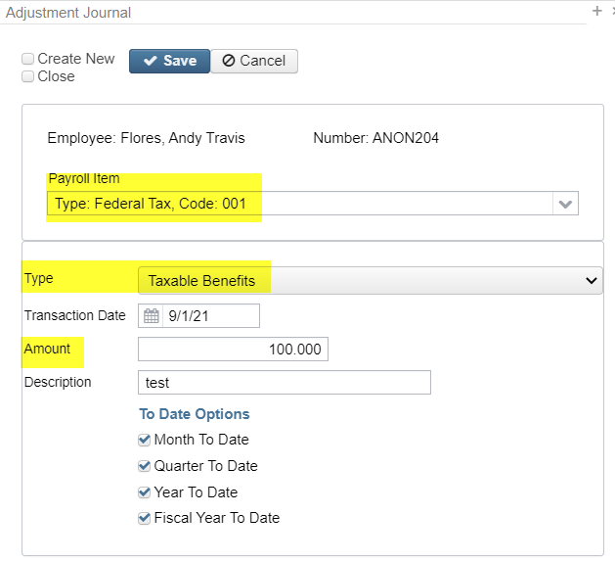
Pre-W2 Processing Taxable Benefits (NC3)

Slide 19
Pre-W2 Processing- Life Insurance
•Group Term Life Insurance – Entered thru payroll before last pay in 2023
•IRS Publication 15-B Section 2 pages 13-15
(http://www.irs.gov/pub/irs-pdf/p15b.pdf) contains the calculation table to figure the cost.
•Before the last payment of 2023. In PAYROLL-FUTURE program, the amount should be entered choosing the Life Insurance Premium-Pay Type. This pay type represents one kind of non-cash earnings for the employee.

Slide 20
Pre-W2 Processing- Life Insurance
Cost of group-term life insurance over $50,000 coverage is taxable
Calculate the cost:
Amount of insurance minus 50,000 (A)
Find cost per $1,000 of coverage per month

Slide 21
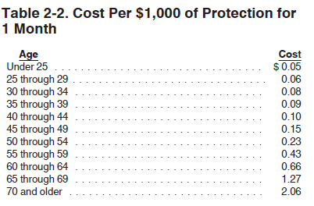
Pre-W2 Processing- Life Insurance Calculations
IRS Publication 15-B page 13-15

Slide 22
Pre-W2 Processing- Life Insurance Calculations
Example – 60 year old with $150,000 worth of group-term life insurance that has worked all year
150,000-50,000 = 100,000
100,000/1,000 = 100
.66 X 12 X100 = 792.00
792.00 will be used for “Life Insurance Premium” in Payroll Future

Slide 23
Pre-W2 Processing-Life Insurance (continued)
For the Life Insurance Premium amount, the tax amounts for Medicare and Social Security will be calculated during the Initialization of the payroll No Federal, Ohio, or OSDI tax amounts will be calculated. All of these will be treated according to the federal rules.
The software provides the ability to withhold city tax on non-cash earnings. This can be activated by checking the box next to Tax Non-Cash Earn" on the city tax record on the Payroll Item Configuration screen.

Slide 24
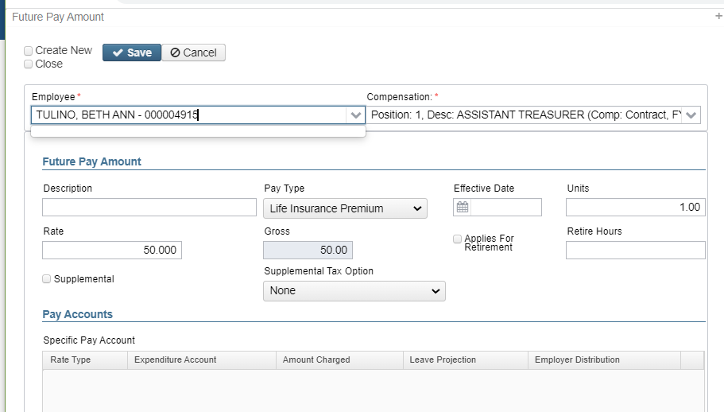
Pre-W2 Processing Life Insurance

Slide 25
Pre-W2 Processing-Dependent Care
•Dependent Care - Max changed from $5000 to $10,500
- If not using the DPCARE Payroll Item type
*Manually enter dependent care amounts in through the Core-Adjustments screen. (Max-$10,500.00 for married filing jointly, unmarried couples and single or $2500.00 married filing separate,)
-Core-Adjustments- Click on Create:

Slide 26
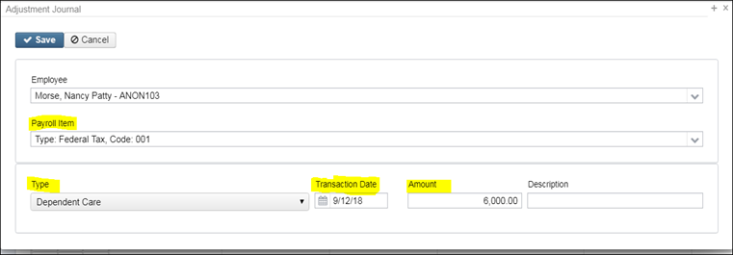
Pre-W2 Processing-Dependent Care (continued)

Slide 27
Pre-W2 Processing-Dependent Care (continued)
When the Save button is clicked this will update the total and taxable gross fields by any amount above the $10,500.00 threshold for any Payroll Item that taxes Dependent Care (Federal, State, City (if applicable) This is then reflected on the W2 Report, W2 Form etc. The total amount of Dependent Care will appear in Box 10 on the W2.

Slide 28
Pre-W2 Processing-Employer Sponsored Health Care Cost
The Affordable Care Act requires employers to report the cost of coverage under an employer-sponsored group health plan. Reporting the cost of health care coverage on the Form W-2 does not mean that the coverage is taxable. This total includes the employee and employer payments for Medical Insurance. This is informational purposes only.

Slide 29
Pre-W2 Processing-Employer Sponsored Health Care Cost (continued)
•Must report the cost of employer-sponsored Health Coverage in Box 12 using Code DD if the district filed 250 or more W2’s for the preceding calendar year
•Life, Dental and Vision are not required to be included in the total if they are separate plans and not included as part of the medical plan
http://www.irs.gov/uac/Form-W-2-Reporting-of-Employer-Sponsored-Health-Coverage
**Note-The contribution amount by Employee and Employer for Health Saving Account (HSA) is NOT to be included as employer-sponsored health coverage. This is reported in Box 12 using (Code W).

Slide 30
Pre-W2 Processing-Employer Sponsored Health Care Cost (continued)
•The box “Employer Health Coverage”on the Regular and Annuity Payroll Item Configuration plus any Core-Adjustments-Health Insurance entries are used to calculate the Employer Sponsored Health Care Cost.
•If this Employer Health Coverage box is checked the YTD Payroll Item totals will be included in the total moved to the employees W2 for Employer Health Coverage.

Slide 31
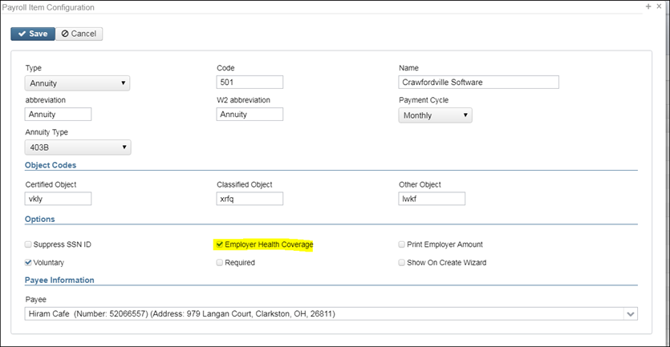
Pre-W2 Processing-Employer Sponsored Health Care Cost (continued)

Slide 32
Pre-W2 Processing-Employer Sponsored Health Care Cost (continued)
•If the district only tracks the employee portion of health care costs in the USPS system, the district will need to create a spreadsheet using the appropriate header information. See-- https://mcoecn.atlassian.net/wiki/spaces/uspsrdoc/pages/2491413/Mass+Load
•with the Board YTD costs for Employee Health Insurance
This will adjust the YTD amounts

Slide 33
Pre-W2 Processing-Employer Sponsored Health Care Cost (continued)
•UTILITIES:MASS LOAD/ADJUSTMENTS can be used to load a csv file that contains the Board Amount of Payroll Item data that was not tracked in the payroll system into Adjustment Journal

Slide 34
Pre-W2 Processing-Employer Sponsored Health Care Cost (continued)
Fields needed for Mass Load
employee.number
payrollitem.code = 001
amount = adjustment amount
transactionDate
type = Healthinsurance
description
The file needs to be saved as Excel then as CSV
Notes:
All to date fields default to True if none are listed in the spreadsheet.

Slide 35
Pre-W2 Processing-Employer Sponsored Health Care Cost (continued)

Slide 36
Pre-W2 Processing-Employer Sponsored Health Care Cost (continued)
•If any employee is paying for their insurance out of pocket, this amount may be added as follows:
•Go to Core/Adjustments
•Click Create
•Employee-Find Employee by typing in a few characters of first or last name. Choose employee
•Payroll Item-Use Drop Down Choose Federal Tax 001
•Type-From Drop Down Choose Health Insurance
•Transaction Date-Enter in or choose a date from the calendar
•Amount-Enter in Amount - No to date boxes checked
•Description-Enter a Description (optional)
•Click

Slide 37
Pre-W2 Processing-Employer Sponsored Health Care Cost (continued)
If the employee insurance is paid half a year out of pocket and the other half through payroll, the amount paid by the employee will need to be added as follows:
•Go to Core/Adjustments
•Click Create
•Employee-Find Employee by typing in a few characters of first t last name. Choose employee
•Payroll Item-Use Drop Down Choose Federal Tax 001
•Type-From Drop Down Choose Health Insurance
•Transaction Date-Enter in or choose a date from the calendar
•Amount-Enter in Amount
•Description-Enter a Description (optional)
•Click

Slide 38
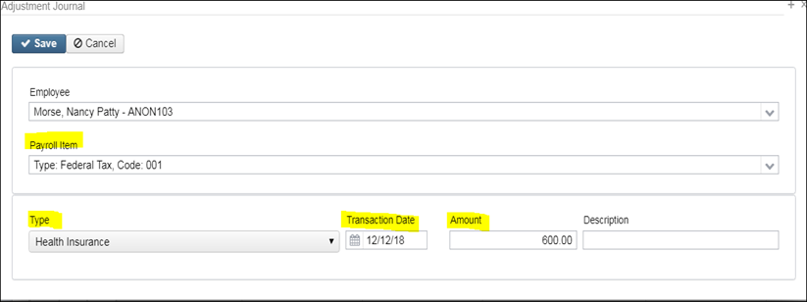
Pre-W2 Processing-Employer Sponsored Health Care Cost (continued)
Manually enter only amount not tracked in USPS system.

Slide 39
Pre-W2 Processing-Employer Sponsored Health Care Cost (continued)
•When the Save button is clicked this will update the total Employer Health Coverage-Code DD withheld for W2 reporting purposes.

Slide 40
Pre-W2 Processing-Employer Sponsored Health Care Cost (continued)
*Note- A spreadsheet can be uploaded with the appropriately formatted data-see https://wiki.ssdt-ohio.org/display/uspsrdoc/Mass+Load using Utilities:Mass Load/Adjustment Journal with Federal Payroll Item Code defined as well as the Type-Health Insurance information.

Slide 41
W2 Report and Submission Features
Program used to generate
- W2 Report-2023.PDF use as a Balancing report
- W2 Tape.TXT Submission file for reporting
- W2 Forms in pdf format

Slide 42
W-2 Report Processing
•Go to Reports/W2 Report and Submission before last pay of 2023 has been completed.
Run the report for Employees with errors only

Slide 43
W-2 Report Processing
•Go to Reports/W2 Report and Submission before last pay of 2023 has been completed. Can be ran as many times as necessary.
•Output Type-Report
–Format-Choose format type desired from drop down (PDF)
–Report Title-Default is W2 Report. Can be changed if desired
–Federal ID Number-Defaults from Core/Organization
–State ID Number-Defaults from Core/Organization

Slide 44
W-2 Report Processing (continued)
–Kind of Employer-S-State and Local Government Employer ( non501c) automatically populates. Can be changed by using drop down
–Sort Options-Choose from drop down
–Report for Year-Current year defaults. Choose from drop down if change needed.

Slide 45
W2 Report Processing
–Additional deduction codes
•Allows districts to print additional information in box 14, “Other”
•Six can be entered
–Leased vehicle value is always included
–Other user values are secondary (Fringe Benefits, SERS, Union Dues)
–Prints the first 3 for each employee in the order entered
–Click the Generate Report button
•Balance to-date data
•Review and correct warnings and errors

Slide 46
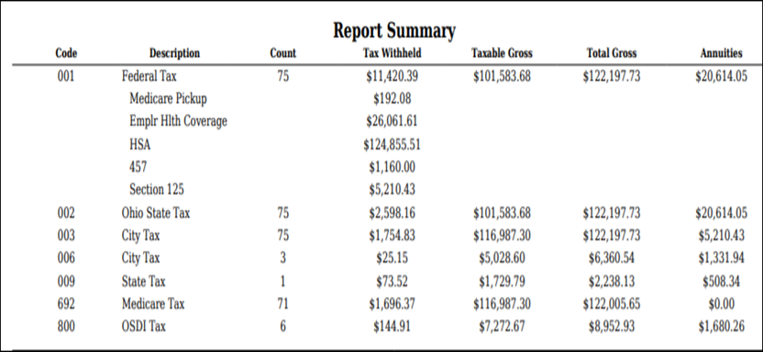
W2 Balancing W2 Report

Slide 47
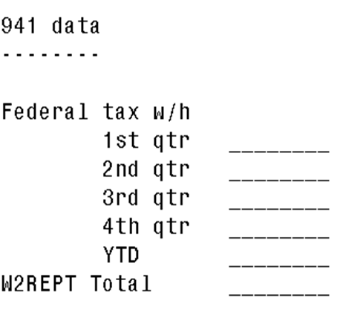
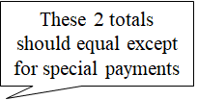
W2 Balancing (continued)

Slide 48
W2 Balancing
•Information on W2 Report should balance to:
–941 totals as reported
–Run Reports/Employee Earnings Register
•Payroll Items represents amounts withheld from employees for the calendar year
* Include Archived Employees & Include Employer Paid Amounts
–Run Reports-Quarter Report
•Represents amounts as current in the YTD figures
–Balance Federal, Ohio, and City taxes and gross amounts

Slide 49
W2 Balancing – Payroll Items and Payables checks
Go to Reports>Payment Transaction Status Report
Report Format: Excel-Data
Sort Options: Check Number or Payroll Item Code
Transaction Type : Deduction Checks
Transaction Status Option: All Status
Issue Start Date: 1/1/2023
Issue Stop Date: 12/31/2023

Slide 50
W2 Balancing – Payroll Items and Payables checks
Open Payment Transaction Status Report in Excel
Delete any deduction checks with Status of V-Voided
Sort and subtotal by Payroll Item Code
Compare these totals to Quarter Report YTD totals
Investigate any differences.
Money received from deduction vendors and returned to employees will make the Quarter Report less than the Payment Transaction Report

Slide 51
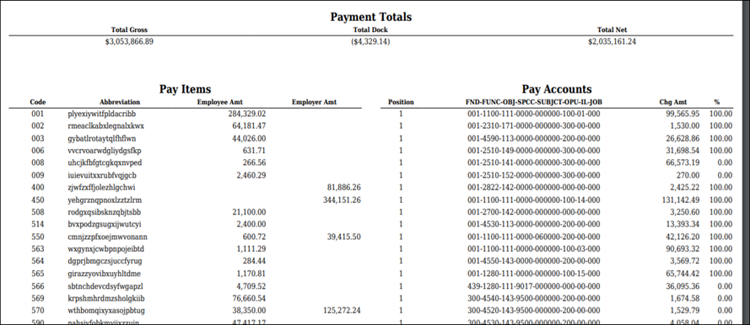
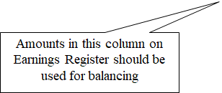
W2 Balancing- Earnings Register

Slide 52
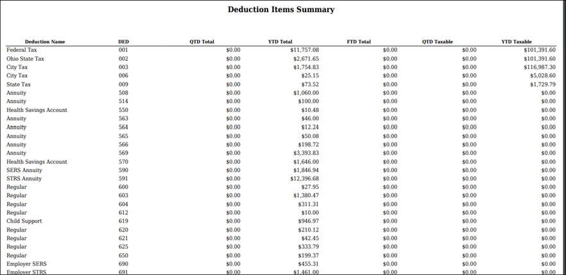
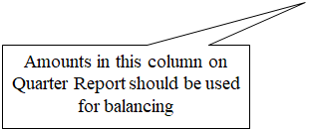
W2 Balancing Quarter Report

Slide 53
W2 Report Diagram

Slide 54
W2 Balancing (continued)
•Items that affect balancing between W2 Report and Quarter (See Specific Affects documentation)
Dependent care benefits over limit ($10,5000.00/or married filing separate-$2500.00)
Fringe Benefits
Medicare pickup amounts
Taxable third party sick pay
Use of company vehicle
Employee expense reimbursements paid through warrant

Slide 55
W2 Balancing (continued)
•Dependent care benefits
–Amounts over limit ($10,5000.00) are added to total and taxable gross amounts on Federal, Ohio and City total and taxable gross fields on the W2REPT
–Ex-If $16,000.00 is added to Adjustments/Dependent Care on the 001 record $5,500.00 will be added to total and taxable gross fields as stated above.
–This will cause gross amounts on W2 Report to be higher.

Slide 56
Adjustments/Dependent Care

Slide 57
W2 Balancing
•Fringe Benefits
–An Adjustments/Fringe Benefits entry on the 001 record adds all fringe benefit amounts to total and taxable gross amounts on Federal and Ohio records
–Will cause gross amounts on W2 Report to be higher

Slide 58
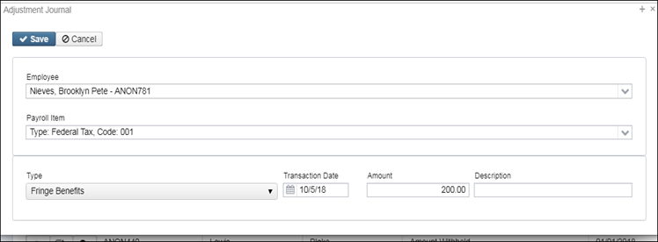
Fringe Benefits

Slide 59
W2 Balancing (continued)
•Medicare Pickup
–Amount added to total and taxable gross amounts on Federal, Ohio and OSDI records
–Will cause gross amounts on W2 Report
to be higher.

Slide 60
W2 Balancing (continued)
If ‘Tax Employer Amounts’ option is not used on the city tax record on the Payroll Item Configuration record -(Tax Employer Amounts box unchecked on Payroll Item Configuration)
The Medicare Pickup box should be checked if the city taxes the Medicare pickup
The Medicare pickup is added to the city total and taxable gross amounts on the W2 Report.
–Employee pays tax after the fact

Slide 61
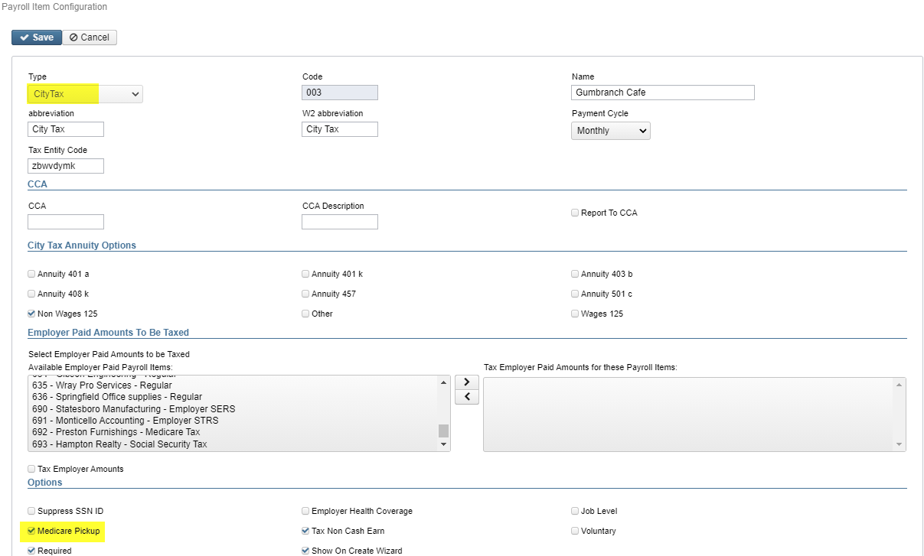
W2 Balancing (continued)

Slide 62
W2 Balancing (continued)
If the ‘Tax Employer Amount’ is used on the city tax record-(Tax Employer Amounts box checked on Payroll Item Configuration)
–The tax is withheld during the payroll

Slide 63
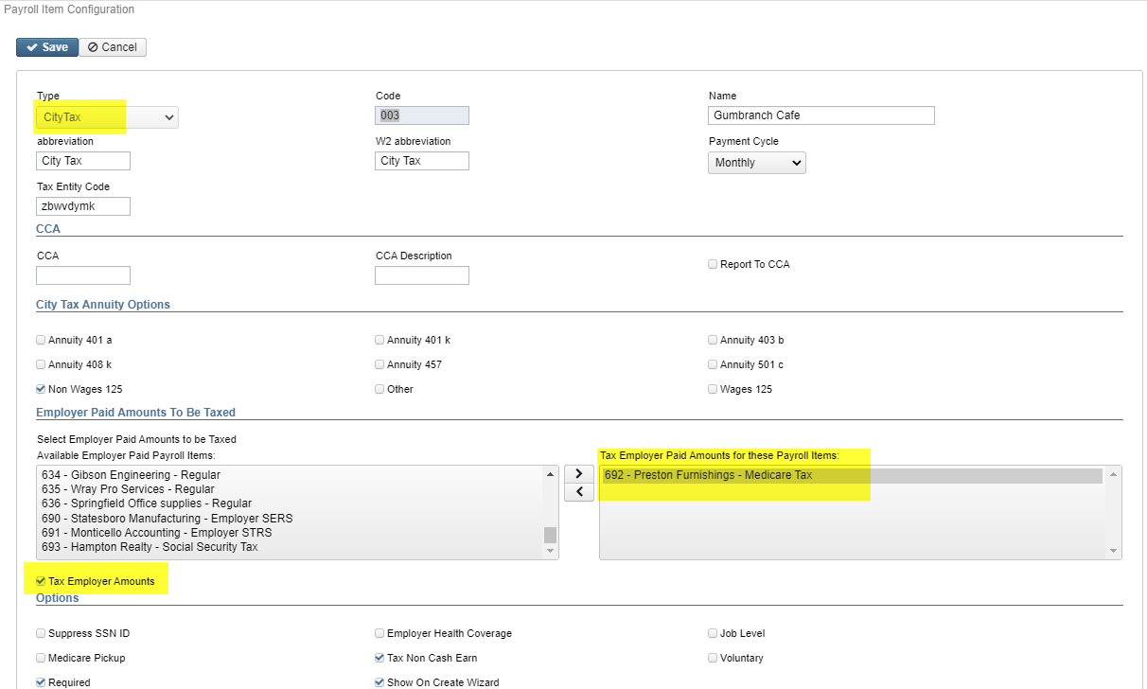
W2 Balancing (continued)

Slide 64
Taxable Third Party Sick Pay
•Taxable Third Party Sick Pay
–Users need to add the Third Party Sick pay amount using Adjustments/Total Gross and Adjustments/Taxable Gross on the Federal (001), Ohio (002) and OSDI (8XX) records as needed
–Will cause gross amount on W2 Report to be higher
•See Third Party Sick Pay Instructions Document
•See Third Party Sick Payment Notification Example Document

Slide 65
W2 Balancing
Third Party Sick Pay

Slide 66
Non-Taxable Third Party Sick Pay
•Non-taxable third party sick pay
–Does not affect balancing
–Does not affect taxes
–Add amount using Adjustments/Third Party Pay to the Federal Tax (001) record. Ytd =Yes
•District is notified how much to enter by third party
–This amount will print in Box 12 with a code ‘J’

Slide 67
Employee Reimbursements
•If district wants employee reimbursements originally paid through warrant to appear on the W2 as wages and adjustments are made, this will create a balancing difference between Quarter Report and W2 Report
•May cause W2 Report to show higher gross amounts than actually paid through USPS
•See ‘Expense Reimburse’ document for more details

Slide 68
Balancing Problems
•Voided checks from prior calendar year
–Go to Payments/Check Register on the grid use the Transaction Type of =Payroll, Status enter in a V and Void Date >12/31/2022. This will pull in all voided checks dated between 01/01/23 and 12/31/23.
Then do the same for Transaction Type of =Refund
Voided Direct Deposits – Payments/Payroll/Direct Deposits
–The report option can then be used to create a report of all voided checks.
•To pull all Refund of annuity withheld in prior calendar year
–Go to Payments/Refund Checks Show Issued Date on grid and then filter 01/01/2023..12/21/2023 click on .
–Do the Same option on the Refund ACH Tab

Slide 69
Balancing Problems (continued)
Manual Updates
Go to Core/Adjustments
Filter Transaction Date (1/1/23..12/31/23)
Filter Code (ex. 001)
Search for any Types manually added- (ex. Fringe Benefit, Health Insurance, Dependent Care, Vehicle Lease, etc) OR
Filter Codes (or 501..550)
Filter Type that is out of balance (ex. Total Gross, Amount Withheld, etc)

Slide 70
Common W2 Error Messages
•Warning: Calculated annuity amount exceeds the total annuities
–Indicates the total gross minus applicable gross is greater than total annuities from the YTD deduction amounts
–Indicates possible problem with annuity amounts, gross or applicable gross
•Verify manual adjustment updates
•Verify error adjustments

Slide 71
Common W2 Error Messages (continued)
•Error: Invalid SSN
–SSA defines series of SSNs as invalid
•Verify SSN with employee’s SS card
•Go to Core/Employees-Using the grid locate the employee.
Click and update the SSN with the correct SSN. Click

Slide 72
Common W2 Error Messages (continued)
•Error: Medicare amount does not equal 1.45% of Medicare gross
-Medicare taxable gross may be incorrect due to missed medicare on a check
–Medicare tax may be incorrect
•Verify amounts
•SSA/IRS may not accept with incorrect amounts

Slide 73
Common W2 Error Messages (continued)
–Verify manual adjustment updates
–Check medicare pickup records
•Must have 692 or 693 with Employer amount 2.9%

Slide 74
Common W2 Error Messages (continued)
•Warning: Negative annuity on file for this employee. Assuming zero
•A total negative annuity indicates a check was voided from a prior calendar year in the current calendar year. Run the REPORTS/PAYMENT TRANSACTION STATUS REPORT option to attempt to isolate the problem. If this is the case, you will need to zero the negative amount of the annuity and file a W2-C form for the previous calendar year
OR
•If desire to report it as if withheld and refunded in current calendar year
•Use Core/Adjustment and zero annuity amount by entering a positive figure that coincides with that negative figure.
•Use Core/Adjustments and increase total gross amounts on federal, Ohio, OSDI and city, if the city honored the annuity initially

Slide 75
Common W2 Error Messages (continued)
•Warning:Federal Total annuities $xxxx.xx does not equal total gross less applicable gross
–Calculated annuity amount (total gross less applicable) does not match the YTD annuity amounts from Payroll Item
–Program compares total annuities from Payroll Items to total gross less applicable gross calculation, uses federal tax record
–Possible problem with annuity total
–Possible problem with total gross
–Possible problem with applicable gross

Slide 76
Common W2 Error Messages (continued)
•Federal Total annuities $xxxx.xx do not equal total gross less applicable gross (continued)
•Verify manual adjustment updates
•Verify refund of deductions
–If refund from prior calendar year and district wants it to appear as if amounts were withheld and refunded in current calendar year
»Increase total gross on Federal, Ohio, OSDI and city if they initially honored the annuity by using Core/Adjustments

Slide 77
Common W2 Error Messages (continued)
•Info-Pension Plan flag on federal record is overriding W2PROC calculations
–If the Federal Payroll Item has the Pension Plan marked “No, never check the pension plan box”, but finds an active retirement record
–If Federal Payroll Item has the Pension Plan marked to “Automatically check the pension plan box based on retirement” or “Yes, check the pension plan box” but does not find an active retirement record
–Common to receive this informational for students who do not participate in SERS
•No action is needed

Slide 78
Common W2 Error Messages (continued)
•Info:Payroll Item XXX:Possible error in OSDI gross or tax
–Indicates taxable OSDI wages but no tax was withheld
•Common informational for employees who have smaller wage amounts per payroll
•Verify amounts
•Usually no action is needed

Slide 79
After Final Pay
Finish the last pay
Balance one last time
Complete regular Month-End Closing
https://mcoecn.atlassian.net/wiki/spaces/uspsrdoc/pages/2490742/USPS-R+Month+End+Balancing+Checklist
Create ODJFS Report: Go to Reports>ODJFS Reporting>ODJFS Report.
When all data is correct, go to Reports>ODJFS Reporting>ODJFS Report and click on Generate Submission File

Slide 80
Quarter Closing
ODJFS
Create ODJFS Report: Go to Reports>ODJFS Reporting>ODJFS Report.
When all data is correct, go to Reports>ODJFS Reporting>ODJFS Report and click on Generate Submission File to create the submission file.
Print Quarter Report – Reports>Quarter Report
Verify all Payables have been processed to date – Go to Processing>Outstanding Payables – Screen should be empty

Slide 81
Quarter Closing
Complete and file required Quarter-End Submission forms – 941
OAPSE Report (for Calendar Year)
Home>OAPSE Report
Format: Excel-Data
Query Options: Enter your OAPSE Payroll Item code(s)
Click Generate Report
Save in your files for reporting of Annual Wages to OAPSE
Print or Save other Quarter End Reports (Optional)
Reports>Employee Master (all data)
Reports>Employee Earnings Register

Slide 82
W2 REPORTS
Reports>W2 Reports>W2 Reports and Submissions
Run W2 reports to look for errors and balance
Create W2s for printing – W2 Mailable Forms
Create submission files for Federal and Ohio
If applicable – create submission files for RITA, PA and any other cities
Create W2s for HR Kiosk - W2 Archive Individual Forms

Slide 83
W-2 Report Processing
•Go to Reports/W2 Report and Submission
Can be ran as many times as necessary.
•Output Type-Report
–Format-Choose format type desired from drop down
–Report Title-Default is W2 Report. Can be changed if desired
–Federal ID Number-Defaults from Core/Organization
–State ID Number-Defaults from Core/Organization

Slide 84
W-2 Report Processing (continued)
–Kind of Employer-S-State and Local Government Employer ( non501c) automatically populates. Can be changed by using drop down
–Sort Options-Choose from drop down
–Report for Year-Current year defaults. Choose from drop down if change needed.

Slide 85
W2 Report Processing
–Additional deduction codes
•Allows districts to print additional information in box 14, “Other”
•Six can be entered
–Leased vehicle value is always included
–Other user values are secondary (Fringe Benefits, SERS, Union Dues)
–Prints the first 3 for each employee in the order entered
–Click the Generate Report button
•Balance to-date data
•Review and correct warnings and errors

Slide 86
Creating W2 Forms
**New for 2023**
Reports>W2 Reports>W2 Mailable Forms
Kind of Employer: S
Report for Year: 2023
Select Payroll Item Configurations (for box 14)
No need to Select Pay Groups if printing all
Click on Generate Mailable Forms button
File will be W2Forms.zip in Reports>W2 Reports>W2 Form Output Files
Click on the middle icon next to W2Forms.zip to send it to File Archive – NEOMIN will get the file from File Archive

Slide 87
NEOMIN to Submit
2023 W2 Reporting- W2 Submission Files
Go to Reports/W2 Report and Submission
• Output Type-Submission
–Federal ID Number-Defaults from Core/Organization
–Additional Federal ID Number-Can be added if needed
–State ID Number-Defaults from Core/Organization
–Kind of Employer-S-State and Local Government Employer (non501c) automatically populates.

Slide 88
2023 W2 Reporting- W2 Submission Files
–Sort Options-Choose from drop down
–Report for Year-Current year defaults. Choose from drop down if change needed
–Employer Name-Defaults from Core/Organization
–Employer Address first line-Defaults from Core/Organization
–Employer Address second line-Defaults from Core/Organization
–Employer City- Defaults from Core/Organization
–Employer State-Defaults from Core/Organization
–Employer Zip Code-Defaults from Core/Organization
–Contact Name-**Required**
–Contact Phone Number-**Required**

Slide 89
2023 W2 Reporting- W2 Submission Files
–Contact Phone Extension-Optional
–Contact Fax Number-Optional
–Contact Email Address-**Required**

Slide 90
2023 W2 Reporting-W2 Submission Files (continued)
–W2 Report Option is used to create:
-SSA W2 Submission File
-CCA W2 Submission File
-RITA W Submission File
–W2CITY Option is used to create:
-City W2 Submission File(s)

Slide 91
2023 W2 Reporting-W2 Submission Files (continued)
To create SSA submission file click
To create CCA submission file click
To create RITA submission file click

Slide 92
2023 W2 City Options
(continued)
To create City tape file, click the W2 City Options tab, enter in Tax Entity Code (required) and then click:
NOTE* The city is identified by the tax entity code. This code needs to be entered on the city item configuration under Core/Payroll Item Configuration.
Check ‘Include Amounts For All Cities’? to include all amounts for all Cities
Note - Most Cities want all the other cities for that employee to be reported
Check ‘Include City Name For The Processing City?’ This option will include other cities the employee pays into as well as include the city name for the processing city.
When this box is checked, the system will check the Payroll Item Configuration Abbreviation box, if this is blank, then checks the W2 Abbreviation box, and if this is blank, looks at the Payee City address.

Slide 93
2023 W2 Reporting-W2 Submission Files (continued)
–W2 State Option is used to create:
-State of Ohio W2 Submission File
-State of Michigan W2 Submission File
-State of Indiana W2 Submission File
-State of Kentucky W2 Submission File
-State of West Virginia W2 Submission File
-State of Pennsylvania Submission File
-State of Pennsylvania CSV Transmittal File

Slide 94
2023 W2 Reporting-W2 Submission Files (continued)
To create State tape file(s) click the W2 State button and then click the applicable State wishing to create a file for.
Each State setup is unique so populate accordingly.
Pennsylvania-

Slide 95
W2 Instructions Reviewed
•Specific details on 2023 W2 form reporting requirements
–Found at
•http://www.irs.gov/pub/irs-pdf/iw2w3.pdf

Slide 96
W2 Instructions Reviewed (continued)
•Corrections (Page 26- 2023 Instructions for Forms W-2 and W-3)
–Use W2-C form
–A W3-C form must accompany a W2-C form
W3-C form corrects totals submitted on tape file by ITC
–Incorrect address
W2-C form not required

Slide 97
W2 Instructions Reviewed (continued)
•Deceased employee’s wages (Page 8 -2023 Instructions for Forms W-2 and W-3
–If payment is made in year employee died
•W2 reporting required
•1099 reporting required
–If payment is made in year after the death of employee
•1099 reporting required

Slide 98
W2 Instructions Reviewed (continued)
•Designated Roth IRA amounts (Page 8 -2023 Instructions for Forms W-2 and W-3)
•Educational Assistance (pages 9)
–Verify taxability with legal advisor
•Employee business expense reimbursements
•(Page 9)
–Verify taxability with legal advisor

Slide 99
W2 Instructions Reviewed (continued)
•Employee taxes paid by employer (Page 9 and 16 - 2023 Instructions for Forms W-2 and W-3)
–Medicare pickup
•Fringe benefits (Page 10)
–Verify taxability with legal advisor
•Group-term life insurance (Page 10)
–Over $50,000 provided
•Must use Publication 15-B table and calculate taxable value of premium, page 13-16
•NOTE: Print 15-B now – IRS updates this early for new tax year

Slide 100
W2 Instructions Reviewed (continued)
•Health Savings Account (HSA) (Page 11- 2023 Instructions for Forms W-2 and W-3)
•Lost W2 form (Page 11)
–Hand type new form
•Enter “REISSUED STATEMENT” on new copy

Slide 101
W2 Instructions Reviewed (continued)
•Moving Expenses (Page 11 -2023 Instructions for Forms W-2 and W-3) **Only for members of the US Armed Forces**
•Third Party (Sick Pay) (Page 13)
–Verify taxability using information received from annuity company
–Pages 14-21 in Publication 15-A includes specific instructions
http://www.irs.gov/pub/irs-pdf/p15a.pdf

Slide 102
W2 Instructions Reviewed (continued)
•Box a (Page 15 -2023 Instructions for Forms W-2 and W-3)
–Employee SSN as entered in Employee screen.
•Box b (Page 16 -2023 Instructions for Forms W-2 and W-3)
–Federal EIN
•Box c (Page 16 -2023 Instructions for Forms W-2 and W-3)
–Employer information as entered in W2PROC

Slide 103
W2 Instructions Reviewed (continued)
•Boxes e and f (Page 16 - 2023 Instructions for Forms W-2 and W-3)
–Employee’s name and address
•Data from Employee Screen
–Uses legal name if non-blank
–Uses name field if legal name is blank
•Box 1(Page 16)
Wages from federal taxable gross amount

Slide 104
W2 Instructions Reviewed (continued)
•Box 2 (Page 17 - 2023 Instructions for Forms W-2 and W-3)
–Tax withheld for YTD on federal tax record
•Box 3 (Page 17)
–Social security wages from 692/693 records flagged as a Payroll Item-Social Security Tax

Slide 105
W2 Instructions Reviewed (continued)
•Box 4 (Page 17 -2023 Instructions for Forms W-2 and W-3)
–Social security taxes withheld from the 692/693 and 692/693 records flagged as Payroll Item-Social Security Tax
•Box 5 (Page 17)
–Medicare wages from 692/693 records flagged with a Payroll Item-Medicare

Slide 106
W2 Instructions Reviewed (continued)
•Box 6 (Page 17 - 2023 Instructions for Forms W-2 and W-3)
–Medicare taxes withheld on the 692/693 records flagged as Payroll Item-Medicare
•Box 10 (Page 18)
–Dependent care benefits as entered through Adjustments on Federal 001 record

Slide 107
W2 Instructions Reviewed (continued)
•Box 12-Codes (Pages 18-21 -2023 Instructions for Forms W-2 and W-3)
–Code C-Group-term life over $50,000 cost
–Code D-Elective deferrals under a section 401(k) plan
–Code E-Elective deferrals under a section 403(b) salary reduction agreement

Slide 108
W2 Instructions Reviewed (continued)
–Code F-Elective deferrals under a section 408(k)(6) salary reduction
–Code G-Elective deferrals and employer contributions to a section 457(b) deferred compensation plan.
–Code H-Elective deferrals under section 501 c(18)(D) tax exempt organization plan
–Code J-Non taxable sick pay

Slide 109
W2 Instructions Reviewed (continued)
–Code P-Excludable moving expenses (US Armed Forces only)
–Code T-Adoption benefits
–Code W-Employer contributions to Health Savings accounts
Employer contributions include section 125 annuity amounts the employee contributes to a section 125 (cafeteria plan to an HSA.
–Code AA-Designated Roth contributions under a section 401(k)

Slide 110
W2 Instructions Reviewed (continued)
– Code BB-Designated Roth contributions under a 403(b)
– Code DD-Cost of employer-sponsored health coverage
– Code EE-Designated Roth contributions under a governmental section
457(b) plan
– Code FF-Permitted benefits under a qualified small employer health reimbursement arrangement (QSEHRA)
Max reimbursement amount for single $5350.00 and family $10,700.00

Slide 111
W2 Instructions Reviewed (continued)
•Box 13 – (Page 22-2023 Instructions for Forms W-2 and W-3)
–Retirement plan
•401(a)
•401(k)
•403(b)
•408(k)
•501c(18)
Notice 87-16 defines “active participant”

Slide 112
W2 Instructions Reviewed (continued)
•Box 14 - Other (Page 22 2023 Instructions for Forms W-2 and W-3)
–Value of vehicle lease from federal tax record
–Other deductions entered in W2PROC
•Optional possibilities include
–Union dues
–Retirement

Slide 113
W2 Instructions Reviewed (continued)
•W3 form
–Not required unless filing on paper
•Totals on W2 submission file created by W2Report is the substitute for the W3 form

Slide 114
Post W2 Processing
•Corrections before files have been submitted to SSA
–If file submission has not occurred the district can make corrections and regenerate a W2 submission file.

Slide 115
Post W2 Processing (continued)
•Corrections after submission of files by NEOMIN
•In this scenario a W2C and W3C will have to be submitted by the district

Slide 116
Preparing for 2024
•Enter changes in tax withholding rates effective January 1, 2024
–City rates
•https://thefinder.tax.ohio.gov/StreamlineSalesTaxWeb/default_municipal.aspx
•Click on Municipal Income Tax Rate Database Table
–OSDI rates
•https://thefinder.tax.ohio.gov/StreamlineSalesTaxWeb/default_schooldistrict.aspx
•Click on School District Income Tax Rate Database Table

Slide 117
Preparing for 2024 (continued)
-CCA City Rates-
•http://ccatax.ci.cleveland.oh.us/?p=taxrates
-RITA City Rates-
•https://www.ritaohio.com/TaxRatesTable
Review these sites often before W2 time, for any changes or updates.

Slide 118
Preparing for 2024 (continued)
Unsure if employee should be taxed
https://thefinder.tax.ohio.gov/StreamlineSalesTaxWeb/default_municipal.aspx
https://thefinder.tax.ohio.gov/StreamlineSalesTaxWeb/default_schooldistrict.aspx
Lookup Tax Rate
•Address
•Zip Code 5 digit or 9 digit
•Latitude/Longitude

Slide 119
FILING DEADLINE
Reporting Deadlines
City Taxes – February 28, 2024
Federal taxes - January 31, 2024
Ohio
W2s – Jan. 31, 2024
IT-941 – Jan. 31, 2024 – can be completed online
IT-3 –Not needed because we are filing electronically
NEOMIN will submit all W2s to SSA and Ohio by Jan. 28, 2024
City Taxes, RITA and CCA will be submitted at the same time– forms due to NEOMIN by Jan. 20

Slide 120
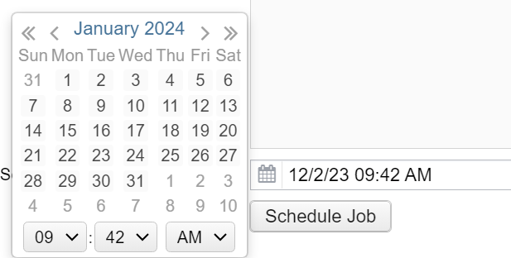
CREATING W2S FOR HR KIOSK
Reports>W2 Reports> W2 Archive Individual Forms
This will create a file of Individual W2s and schedule a job to post them to HR Kiosk
Complete the form with the same information, same sort as when printing your W2s
Click on the calendar to
Schedule the job

Slide 121
NEOMIN Holiday Schedule 2023
December 25, 2023 – Closed
December 26, 2023 – Closed
December 27, 2023 – 8:00 am – 4:00 pm
December 28, 2023 – 8:00 am – 4:00 pm
December 29, 2023 –Closed
January 1– Closed
January 02, 2024 – 8:00 am – 4:00 pm

Slide 122
Questions?

